Slide 1

MATHS IN EYFS
Parent Presentation 2025

Slide 2
EYFS Statutory Educational Programme:
Developing a strong grounding in number is essential so that all children develop the necessary building blocks to excel mathematically. Children should be able to count confidently, develop a deep understanding of the numbers to 10, the relationships between them and the patterns within those numbers.
By providing frequent and varied opportunities to build and apply this understanding – such as using manipulatives, including small pebbles and tens frames for organising counting – children will develop a secure base of knowledge and vocabulary from which mastery of mathematics is built. In addition, it is important that the curriculum includes rich opportunities for children to develop their spatial reasoning skills across all areas of mathematics including shape, space and measures. It is important that children develop positive attitudes and interests in mathematics, look for patterns and relationships, spot connections, ‘have a go’, talk to adults and peers about what they notice and not be afraid to make mistakes.

Slide 3
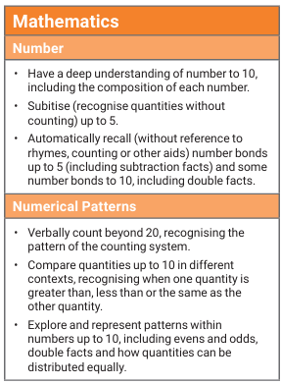
EARLY LEARNING GOALS

Slide 4
Development Matters
Development matters is the non statutory guidance that supports the early years framework and breaks it down into smaller steps.

Slide 5
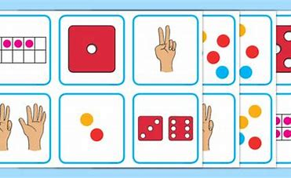
Subitise
Show small quantities in familiar patterns (for example, dice) and random arrangements.
Play games which involve quickly revealing and hiding numbers of objects.
Put objects into five frames and then ten frames to begin to familiarise children with the tens structure of the number system.
Prompt children to subitise first when enumerating groups of up to 4 or 5 objects: “I don’t think we need to count those. They are in a square shape so there must be 4.” Count to check.
Encourage children to show a number of fingers
‘all at once’, without counting.
Notes:
Give dice

Slide 6
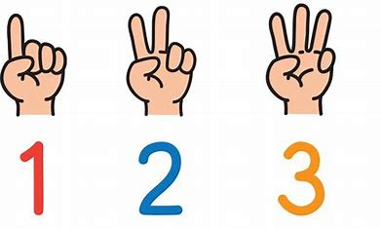
Link the number symbol (numeral) with its cardinal number value.
Display numerals in order alongside dot quantities or tens frame arrangements.
Play card games such as snap or matching pairs with cards where some have numerals, and some have dot arrangements.
Discuss the different ways children might record quantities (for example, scores in games), such as tallies, dots and using numeral cards.

Slide 7
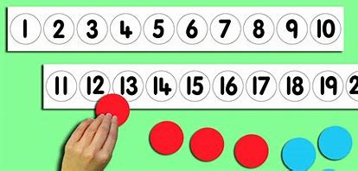
Count beyond ten.
Count verbally beyond 20, pausing at each multiple of 10 to draw out the structure, for instance when playing hide and seek, or to time children getting ready.
Provide images such as number tracks, calendars and hundred squares indoors and out, including painted on the ground, so children become familiar with two-digit numbers and can start to spot patterns within them.

Slide 8
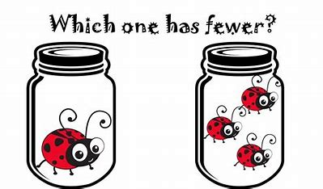
Compare numbers.
Provide collections to compare, starting with a very different number of things. Include more small things and fewer large things, spread them out and bunch them up, to draw attention to the number not the size of things or the space they take up. Include groups where the number of items is the same.
Use vocabulary: ‘more than’, ‘less than’, ‘fewer’, ‘the same as’, ‘equal to’. Encourage children to use these words as well.
Distribute items evenly, for example: “Put 3 in each bag,” or give the same number of pieces of fruit to each child. Make deliberate mistakes to provoke discussion.
Tell a story about a character distributing snacks unfairly and invite children to make sure everyone has the same.

Slide 9
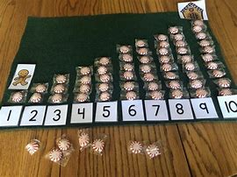
Understand the ‘one more than/one less than’ relationship between consecutive numbers.
Make predictions about what the outcome will be in stories, rhymes and songs if one is added, or if one is taken away.
Provide ‘staircase’ patterns which show that the next counting number includes the previous number plus one.

Slide 10
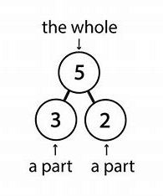
Explore the composition of numbers to 10.
Focus on composition of 2, 3, 4 and 5 before moving onto larger numbers.
Provide a range of visual models of numbers: for example, six as double three on dice, or the fingers on one hand and one more, or as four and two with ten frame images.
Model conceptual subitising: “Well, there are three here and three here, so there must be six.”
Emphasise the parts within the whole: “There were 8 eggs in the incubator. Two have hatched and 6 have not yet hatched.”
Plan games which involve partitioning and recombining sets. For example, throw 5 beanbags, aiming for a hoop. How many go in and how many don’t?

Slide 11
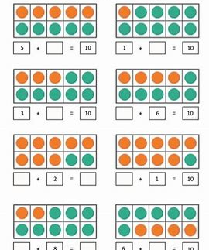
Automatically recall number bonds for numbers 0–5 and some to 10.
Have a sustained focus on each number to and within 5. Make visual and practical displays in the classroom showing the different ways of making numbers to 5 so that children can refer to these.
Help children to learn number bonds through lots of hands-on experiences of partitioning and combining numbers in different contexts, and seeing subitising patterns.
Play hiding games with a number of objects in a box, under a cloth, in a tent, in a cave, etc.: “6 went in the tent and 3 came out. I wonder how many are still in there?”
Intentionally give children the wrong number of things. For example: ask each child to plant 4 seeds then give them 1, 2 or 3. “I’ve only got 1 seed, I need 3 more.”
Spot and use opportunities for children to apply number bonds: “There are 5 of us but only 2 clipboards. How many more do we need?”
Place objects into a five frame and talk about how many spaces are filled and unfilled.

Slide 12
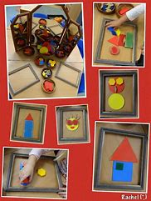
Select, rotate and manipulate shapes to develop spatial reasoning skills.
Provide high-quality pattern and building sets, including pattern blocks, tangrams, building blocks and magnetic construction tiles, as well as found materials.
Challenge children to copy increasingly complex 2D pictures and patterns with these 3D resources, guided by knowledge of learning trajectories: “I bet you can’t add an arch to that,” or “Maybe tomorrow someone will build a staircase.”
Teach children to solve a range of jigsaws of increasing challenge.

Slide 13
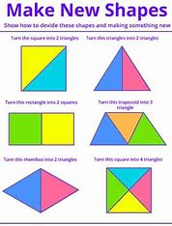
Compose and decompose shapes so that children recognise a shape can have other shapes within it, just as numbers can.
Investigate how shapes can be combined to make new shapes: for example, two triangles can be put together to make a square. Encourage children to predict what shapes they will make when paper is folded. Wonder aloud how many ways there are to make a hexagon with pattern blocks.
Find 2D shapes within 3D shapes, including through printing or shadow play.

Slide 14
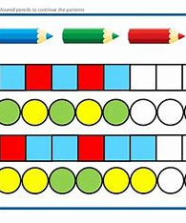
Continue, copy and create repeating patterns.
Make patterns with varying rules (including AB, ABB and ABBC) and objects and invite children to continue the pattern.
Make a deliberate mistake and discuss how to fix it.

Slide 15
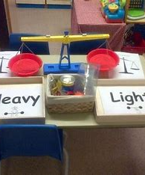
Compare length, weight and capacity.
Model comparative language using ‘than’ and encourage children to use this vocabulary. For example: “This is heavier than that.”
Ask children to make and test predictions. “What if we pour the jugful into the teapot? Which holds more?”

