Slide 1

Teach reading: change lives
Welcome to our Parent/Carers Information Session: Phonics and Early Reading.
23rd September 2024

Slide 2
Phonics and Early Reading
Part 1 – Information about how we teach phonics
Part 2 – Information about how we teach reading
Part 3 – Supporting at home
Part 4 – The link with spelling

Slide 3
A love of reading is the biggest indicator of future academic success.
OECD (The Organisation for Economic Co-operation and Development)

Slide 4




How many times have you already read today?
Notes:
Just think about how many times you have already read things today. It really is a vital skill.

Slide 5

Phonics

Slide 6

Little Wandle Letters and Sounds Revised
Two years ago our school began the journey of using Little Wandle Letters and Sounds Revised as our systematic, synthetic phonics (SSP) programme to teach early reading and spelling. This begins in Reception and carries on year 1. It is also used throughout the school.
Notes:
Last year we introduced Little Wandle to our school and we are really pleased with the programme so far. PSC results were higher last year, then the previous few years. Many year 2 children are reading with fantastic fluency, being able to have a go at age appropriate texts.
Government changes meant a change (for the better) in how we teach phonics and reading at school - make sure there is consistency throughout
Early reading is the stage where children are learning to become fluent readers through the use of phonics
Why Little Wandle?
Excellent training for all staff to ensure consistency.
Every aspect of phonics and reading included in a detailed, thorough and systematic approach.
Engaging resources without distracting from the learning.
Comprehensive system for identifying and supporting children requiring extra help
Useful support for parents.
High quality linked decodable books

Slide 7
Phonics is:
making connections between the sounds of our spoken words and the letters that are used to write them down.

Slide 8
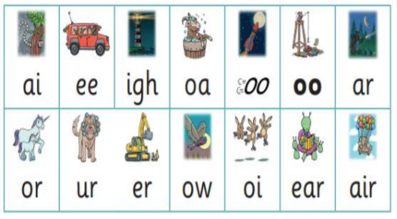
Did you Know?
The English language has:-
26 letters
44 sounds
Over 100 different ways to spell
those sounds!

Slide 9
Terminology
Phoneme
Split vowel digraph
Grapheme
Blend
Digraph
Segment
Trigraph
Notes:
Explain what each word means – use our glossary to help: https://www.littlewandlelettersandsounds.org.uk/resources/my-letters-and-sounds/getting-started/

Slide 10
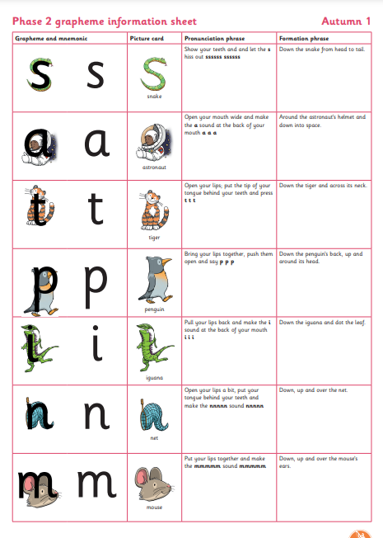
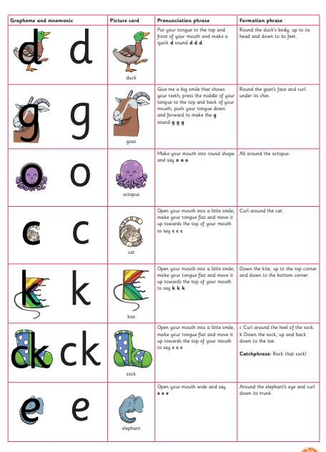
Teaching order – Year R
Notes:
We usually teach four new sounds a week and have a review lesson on a Friday. You will get a list of the sounds that we are learning in their sound books. This will help you with formation and pronunciation.
Ditties to help with handwriting. Will begin cursive in Year 1, using same ditties
Sounds taught in Autumn, Spring and Summer

Slide 12
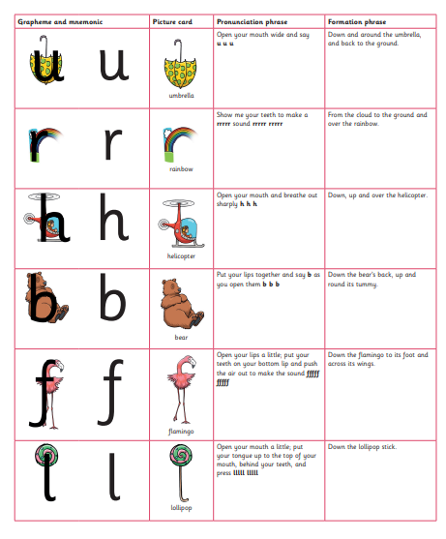
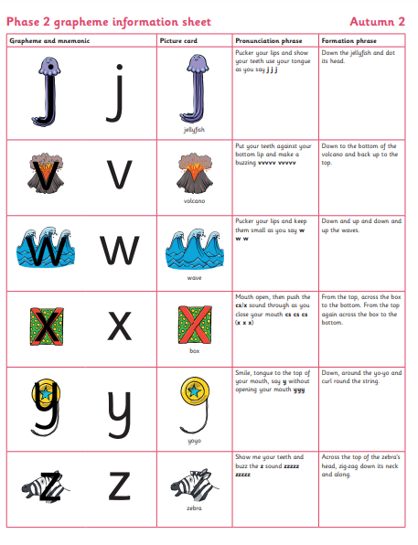

Slide 13
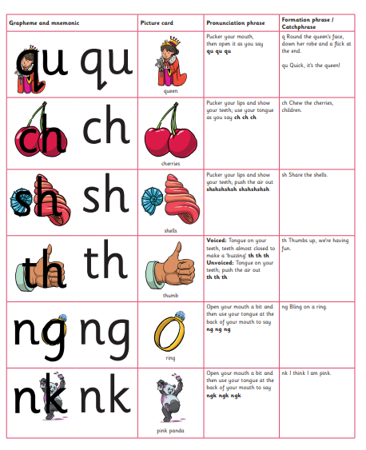
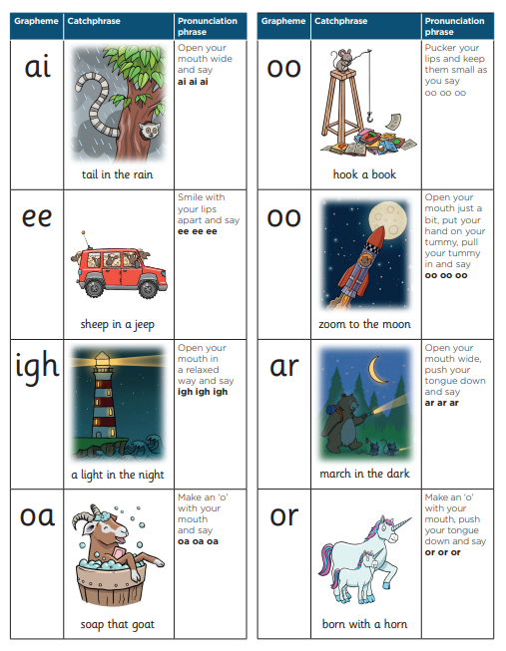

Slide 14
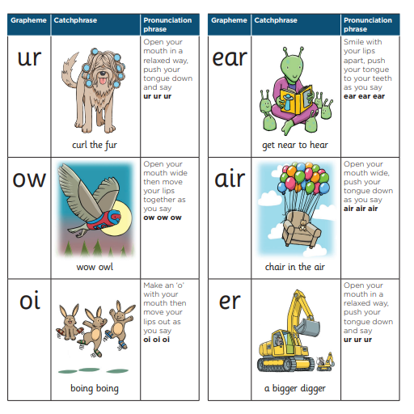

Slide 15

Blending to read words
Notes:
Some children learn to blend really quickly, and others take a little longer. If your child is finding it difficult, ask your child’s teacher for ways to help at home – playing blending games at home is so helpful! There are some videos on the parent section of the Little Wandle website but please only use the sounds that have been taught so far. Can buy the word card sets from Amazon or you could make them from card, backs of cereal boxes etc.
Show this video from the website: https://www.littlewandlelettersandsounds.org.uk/resources/for-parents/

Slide 16

Supporting your child with phonics
Notes:
It is really important that you pronounce the sounds correctly at home when you are supporting your child. These videos are on the website for you to refer to and if you are unsure, please ask your child’s teacher.
Show the parents where to access the videos on the website and play them!
https://www.littlewandlelettersandsounds.org.uk/resources/for-parents/

Slide 17
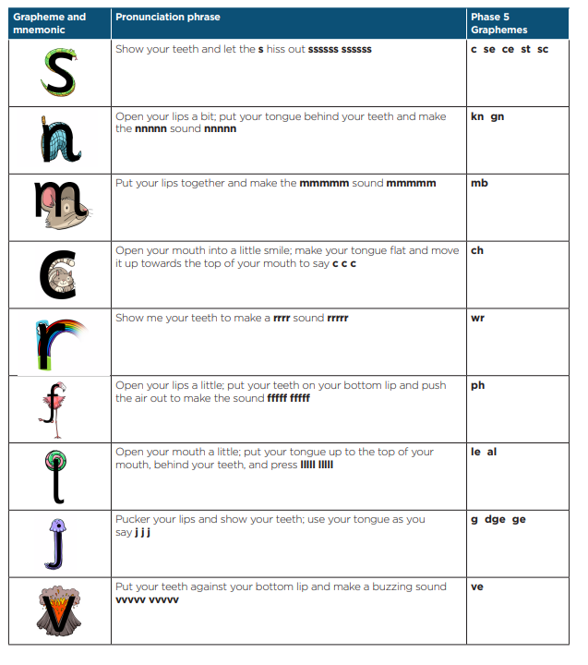
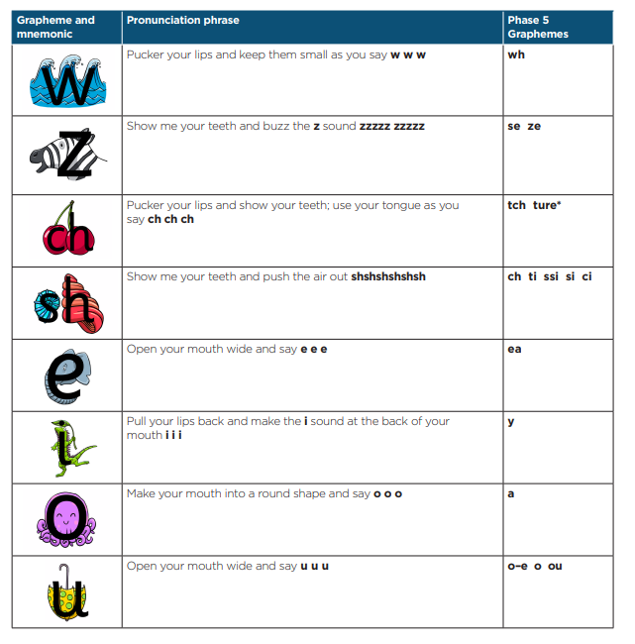
In Year 1 your child continues to learn the entire alphabetic code:
Notes:
We will work our way through the whole Little Wandle Programme until your child can read fluently. The aim is that children leave Year 1 secure in their phonic knowledge and able to read age appropriate texts independently.
Current Year 2 children there are lots of new sounds so we will be covering some of them. Even if your child can read fluently this is important to support spelling.

Slide 18
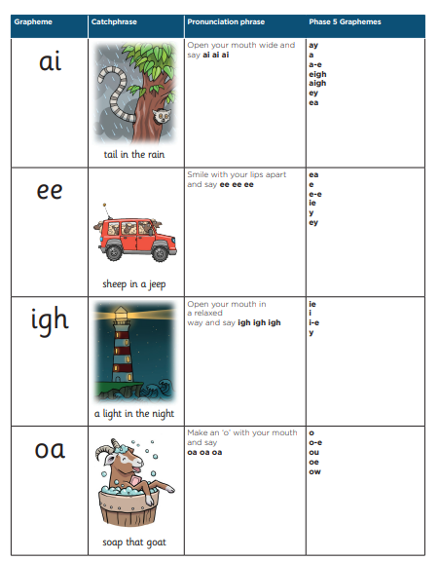
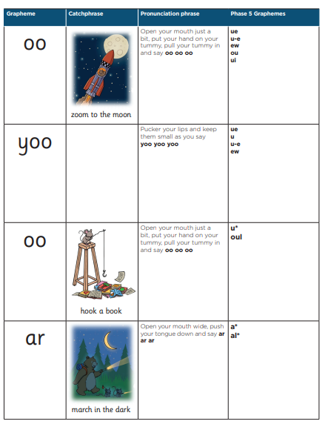

Slide 19
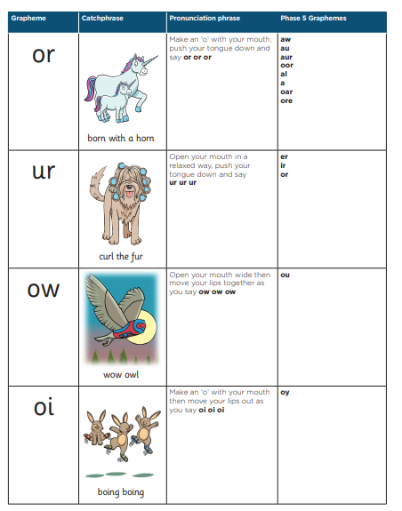
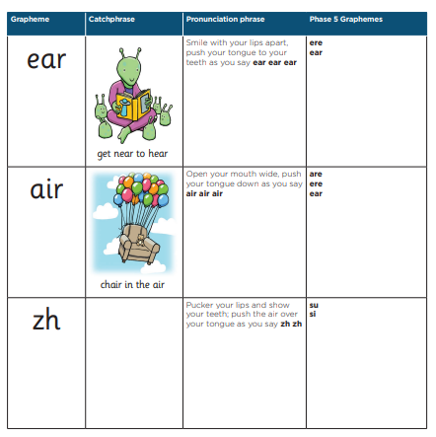
Notes:
https://www.littlewandlelettersandsounds.org.uk/resources/for-parents/

Slide 20


Automaticity
Notes:
This is an example of what the children learn in Year 1.
Children learn that there are graphemes that can have different sounds and sounds that can be made with different letters.
Use the backs and fronts of Phase 5 cards to show ‘ea’ and ‘ow’.

Slide 21


Slide 22
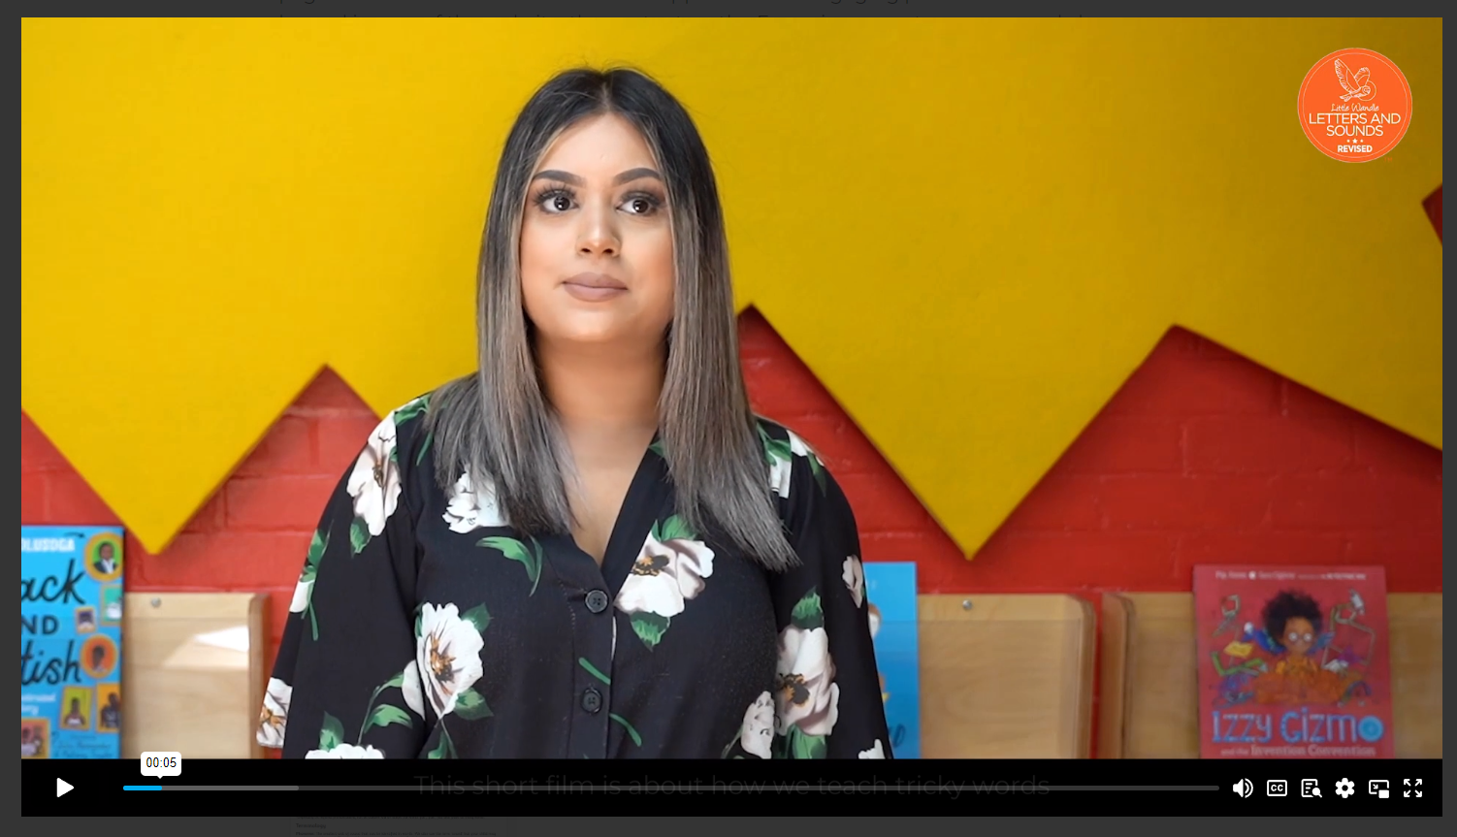
Tricky words
Notes:
Have a look at this video on the website: https://www.littlewandlelettersandsounds.org.uk/resources/for-parents/

Slide 23
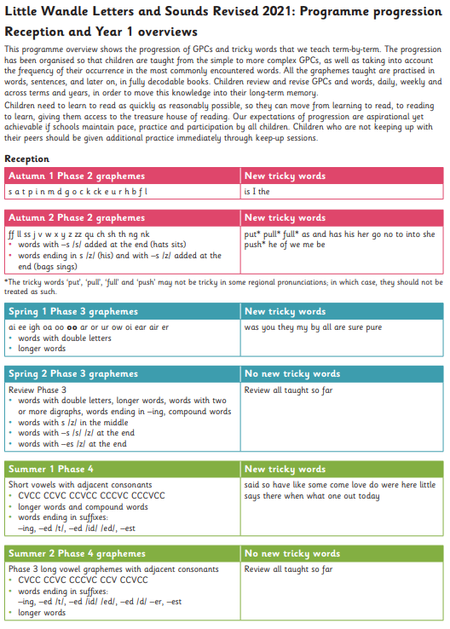

Slide 24
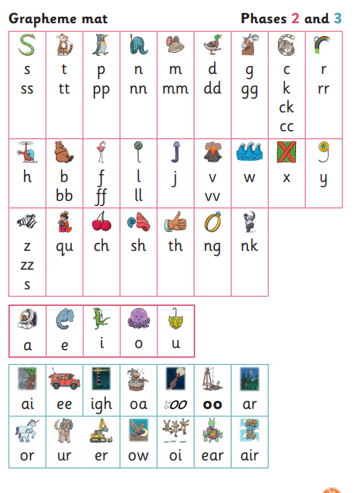




How we make learning stick
Notes:
There are specific resources for the Little Wandle Programme which the children will become very familiar with. Each sound that we teach to begin with has either a mnemonic (like the astronaut that you can see here) or a phrase like boing-boing for ‘oi’. This helps the children recognise and remember the graphemes. Every time we teach a new sound, we also read words during the phonics lesson that contain that new sound so that the children practise what they have learned. We then go on to reading a sentence containing some of those words. We have displays in the classroom and on the tables to support the children throughout the day.

Slide 25
Reading

Slide 26

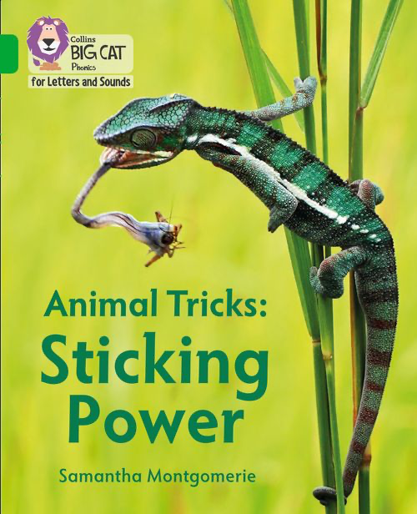
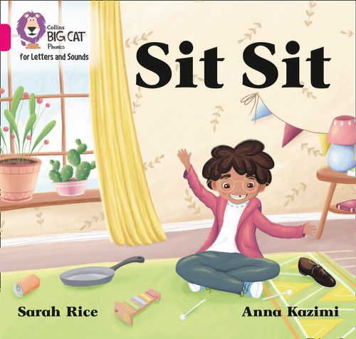
How do we teach reading in books?
Reading practice sessions are:
timetabled three times a week
taught by a trained teacher/teaching assistant
taught in small groups.
Notes:
The children read the same book three times in a week. The first time we work on decoding (sounding out) the words, the second time we work on prosody which is reading with expression – making the book sound more interesting with our story-teller voice or our David Attenborough voice – and the third time we look at comprehension. We read the books three times at school because we want to develop the fluency. The more they see words the more they begin to read them automatically without having to sound them out. We encourage quiet sounding out, leading onto sounding out in their head.

Slide 27


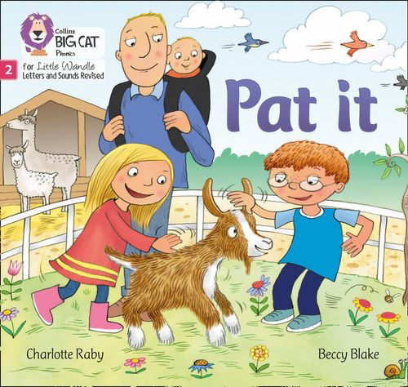

We use assessment to match your child to the right level of book
Notes:
In Year R and Year 1 we assess your child every six weeks to check progress. Any child who needs extra support has daily keep-up sessions planned for them. In Year 2 and above, children receive rapid catch up sessions.

Slide 28

Reading a book at the right level
This means that your child should:
Know all the sounds and tricky words in their phonics book well
Read many of the words by silent blending (in their head) – their reading will be automatic
Only need to stop and sound out about 5% of the words by the time they bring the book home – but they should be able to do this on their own.
Notes:
This does not mean the book is too easy.

Slide 29
Reading at home

Slide 30

The most important thing you can do is read with your child
Reading a book and chatting had a positive impact a year later, on children’s ability to…
understand words and sentences
use a wide range of vocabulary
develop listening comprehension skills.
The amount of books children were exposed to by age 6 was a positive predictor of their reading ability two years later.
Parental involvement in the development of children’s reading skills: A five-year longitudinal study (2002) Senechal, M. and Lefvre, J
Notes:
Celebrate child’s success at school, make time for reading at home!

Slide 31

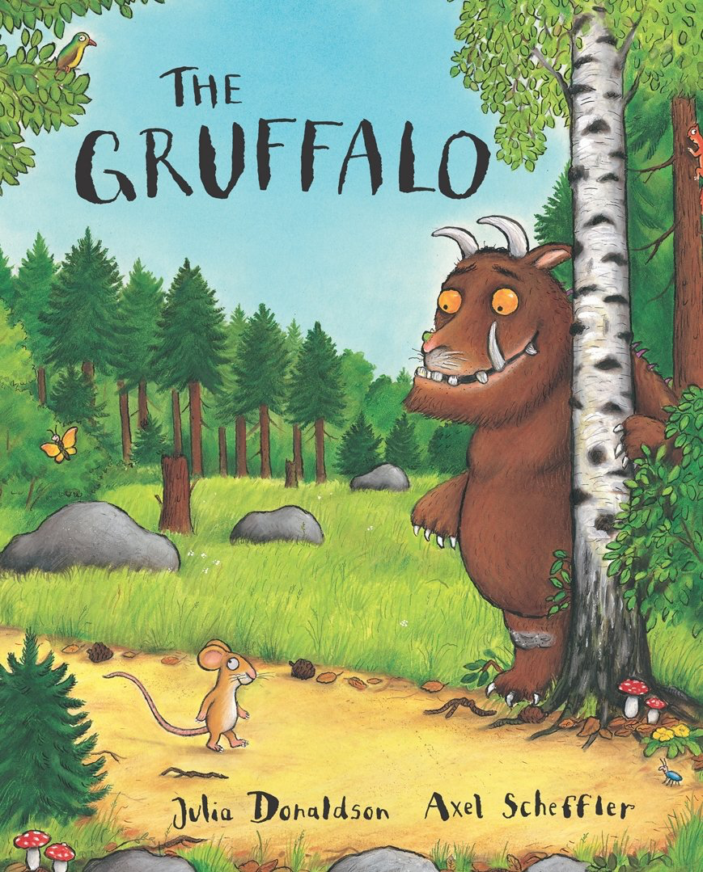
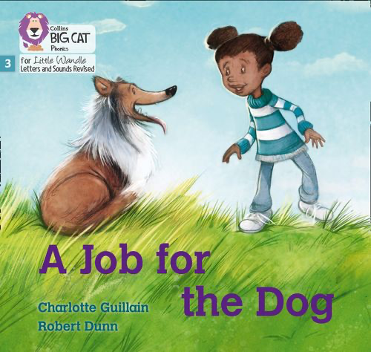


Books going home
E Book
Notes:
As well as the ‘learning to read’ book that your child will access via the e library, they will be bringing home a sharing book.
They will also bring home a book for sharing with you. This book is SO important. This is how we are going to give them the WILL to read. Please read with your child as often as you can – at least once a day if possible.

Slide 32
Listening to your child read their phonics E book
Your child should be able to read their book without your help.
If they can’t read a word read it to them.
Talk about the book and celebrate their success.
Notes:
Please write in reading diaries. Please try to read the most recent as priority. We can see how many times children have been on their e-books and how long they have spent on each book.

Slide 33

Read to your child
The sharing book is for YOU to read:
Make the story sound as exciting as you can by changing your voice.
Talk with your child as much as you can:
  Introduce new and exciting language
  Encourage your child to use new vocabulary
  Make up sentences together
  Find different words to use
  Describe things you see.
Notes:
At school we also have whole class reads, SLS – library bus, topic books.

Slide 34
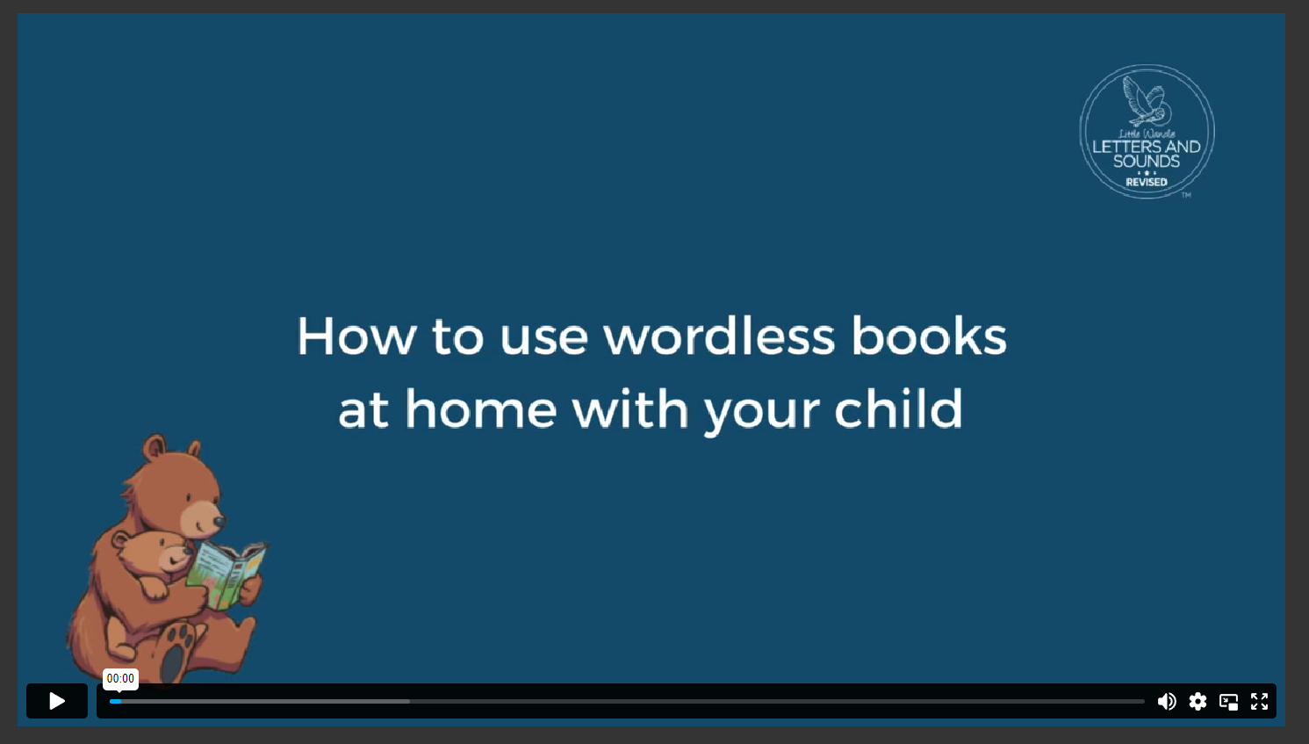
Notes:
At school we also have whole class reads, SLS – library bus, topic books.

Slide 35
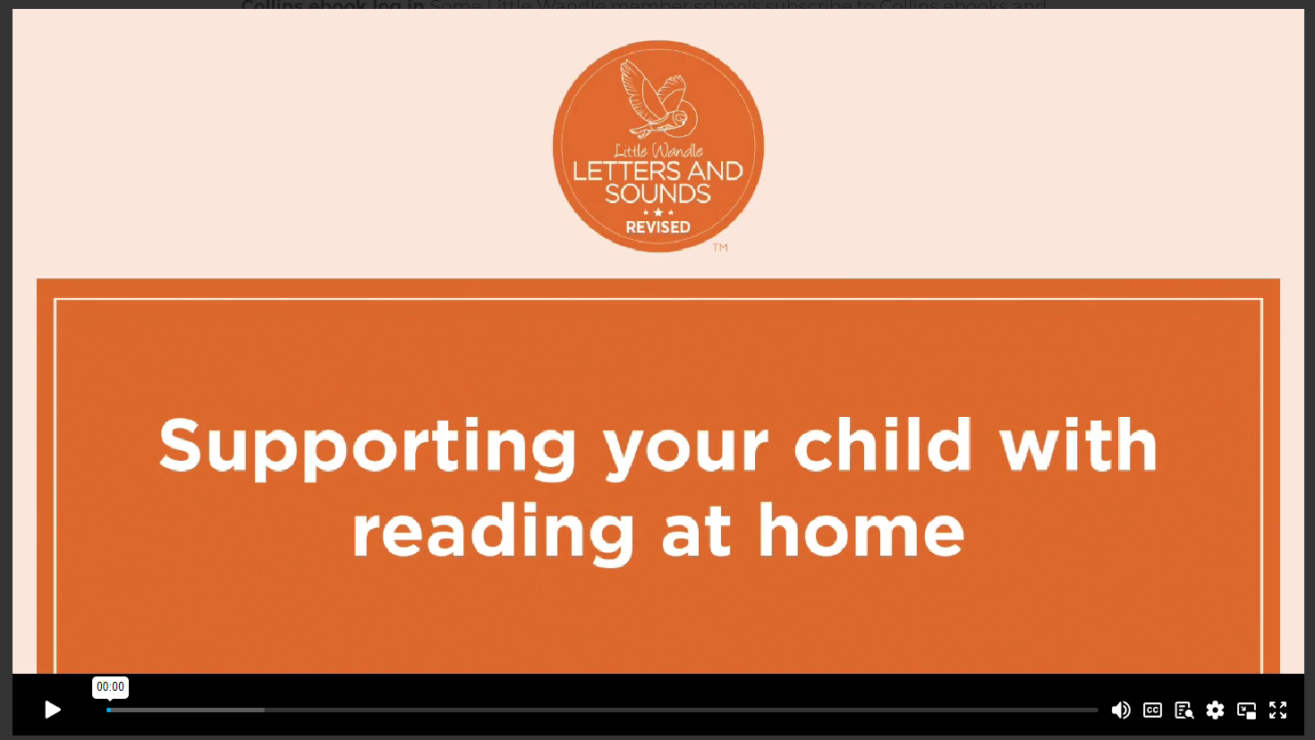
Notes:
At school we also have whole class reads, SLS – library bus, topic books.

Slide 36
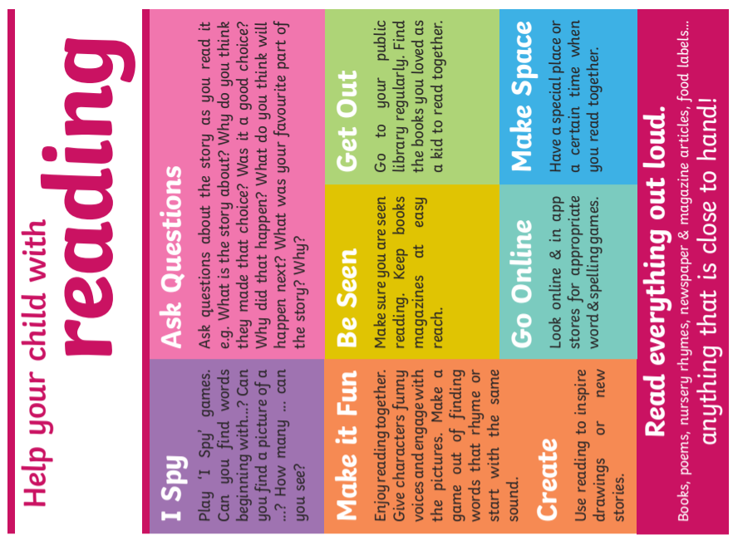

Slide 37
One of the greatest gifts adults can give is to read to children
Carl Sagan

Slide 38
Spelling

Slide 39
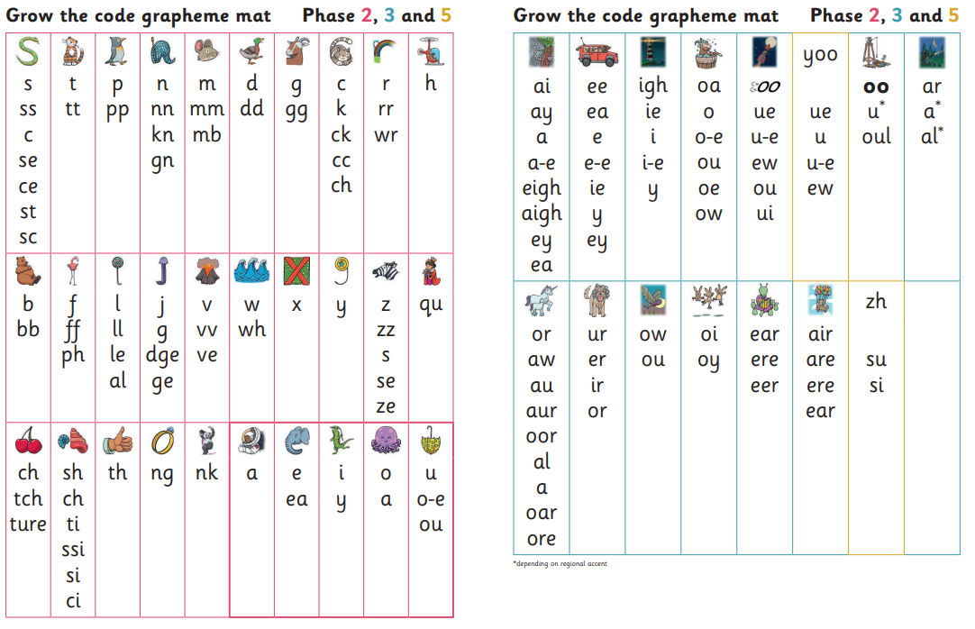
Grow the Code Chart

Slide 40
All the different ways to write the phoneme sh:
shell
chef
special
caption
mansion
passion

Slide 41

Spelling
Say the word.
Segment the sounds.
Count the sounds.
Write them down.
Notes:
Model the process on a flipchart.

Slide 42
Phonics Screening Check (PSC)

Slide 43
Life after Little Wandle!
What happens next?
Notes:
Fluency assessment.
A reading speed of 90 words per minute is required to integrate comprehension whilst reading (Armbruster et al, 2001). But be warned: a fast reading speed alone is not a full measure of fluency. Both accuracy and prosody need to be measured too. Children are unlikely to be reading at 90 words per minute in Year 1, and so not able to read with fluency and comprehension – yet. Children in Year 1 should be reading at 60–70+ words per minute at the end of the programme. Continued reading instruction in Year 2 is therefore crucial in order to teach fluency and enable children to become readers for life. We do this by moving onto purple, gold, white and lime books.

Slide 44
Fluency
Notes:
Fluency assessment.
A reading speed of 90 words per minute is required to integrate comprehension whilst reading (Armbruster et al, 2001). But be warned: a fast reading speed alone is not a full measure of fluency. Both accuracy and prosody need to be measured too. Children are unlikely to be reading at 90 words per minute in Year 1, and so not able to read with fluency and comprehension – yet. Children in Year 1 should be reading at 60–70+ words per minute at the end of the programme. Continued reading instruction in Year 2 is therefore crucial in order to teach fluency and enable children to become readers for life. We do this by moving onto purple, gold, white and lime books.

Slide 45
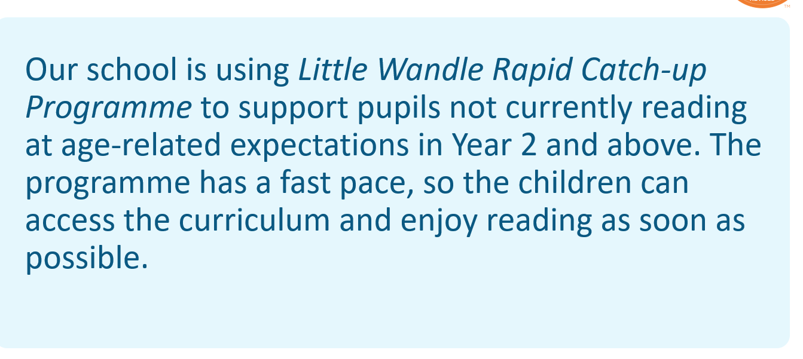
Notes:
Fluency assessment.
A reading speed of 90 words per minute is required to integrate comprehension whilst reading (Armbruster et al, 2001). But be warned: a fast reading speed alone is not a full measure of fluency. Both accuracy and prosody need to be measured too. Children are unlikely to be reading at 90 words per minute in Year 1, and so not able to read with fluency and comprehension – yet. Children in Year 1 should be reading at 60–70+ words per minute at the end of the programme. Continued reading instruction in Year 2 is therefore crucial in order to teach fluency and enable children to become readers for life. We do this by moving onto purple, gold, white and lime books.

Slide 46
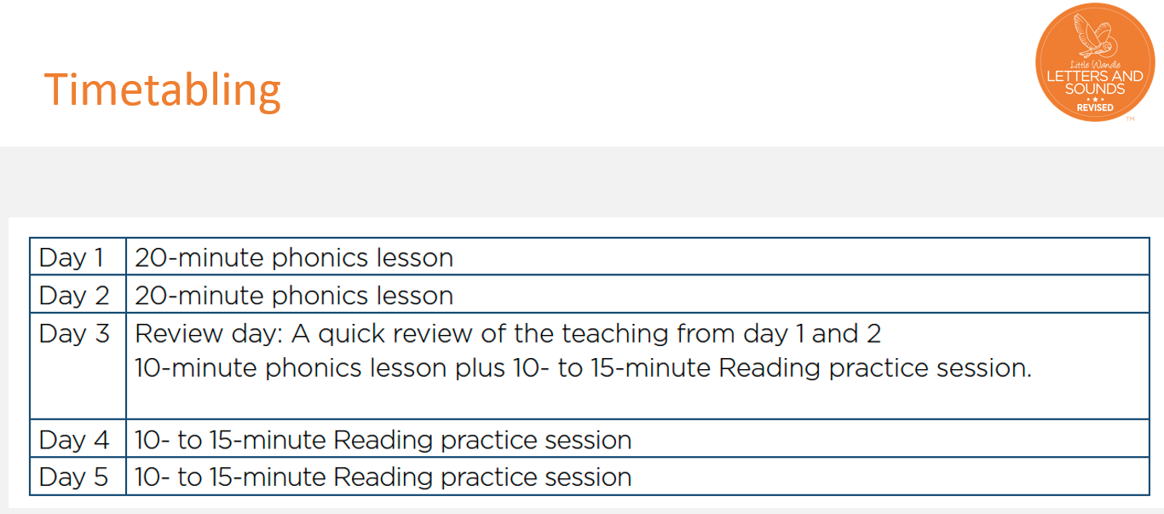

Slide 47
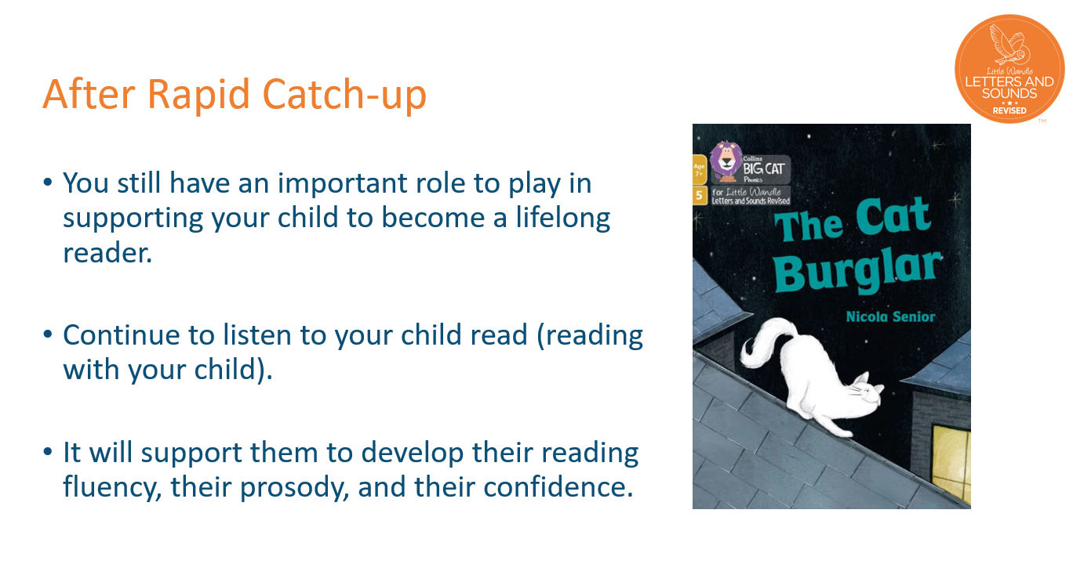

Slide 48
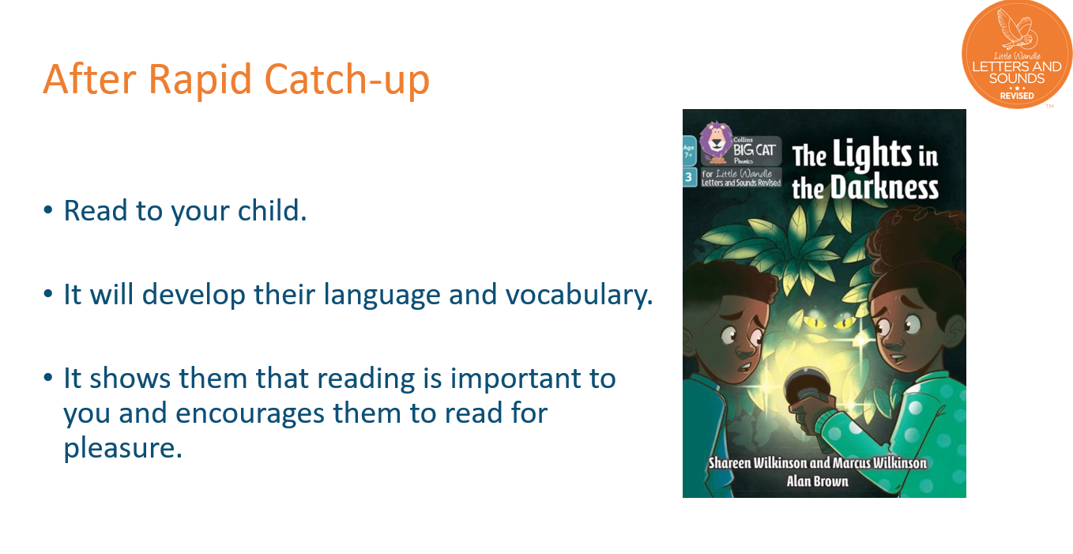

Slide 49
Link to Little Wandle Website for parents/carers https://www.littlewandlelettersandsounds.org.uk/resources/for-parents/
This powerpoint will go onto class pages of school website

Slide 50
Any Questions?
Thank you for attending our information session.

