Slide 2

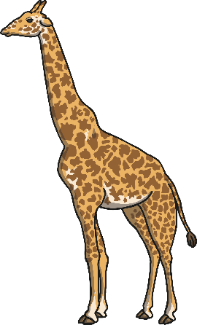

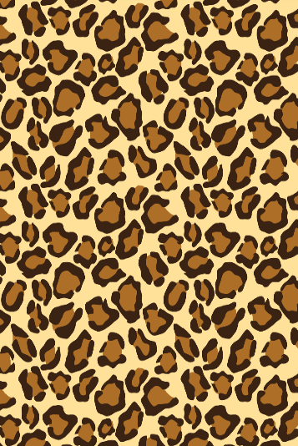

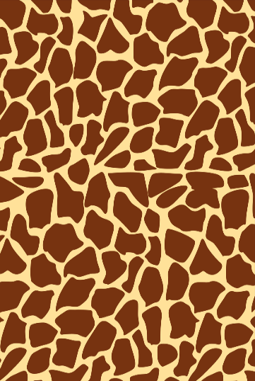
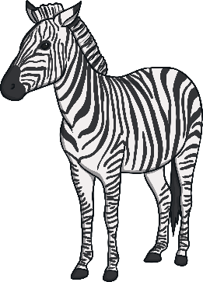
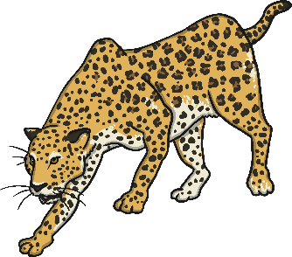


We can see pattern all around us.
Some animals have pattern in their fur.
Can you guess which animal these patterns belong to?
Click the pattern to reveal the animal!
Zebra Leopard Elephant Tiger Giraffe

Slide 3

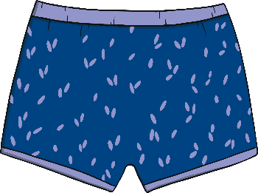
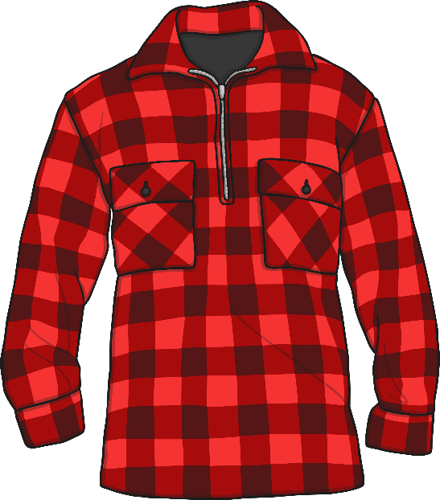
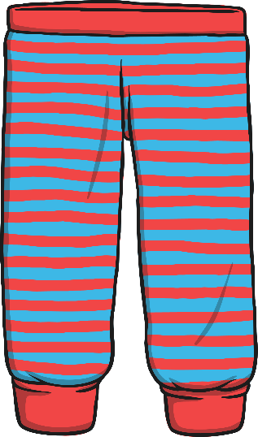


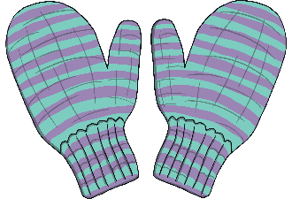
There are also patterns…
On our clothes.

Slide 4

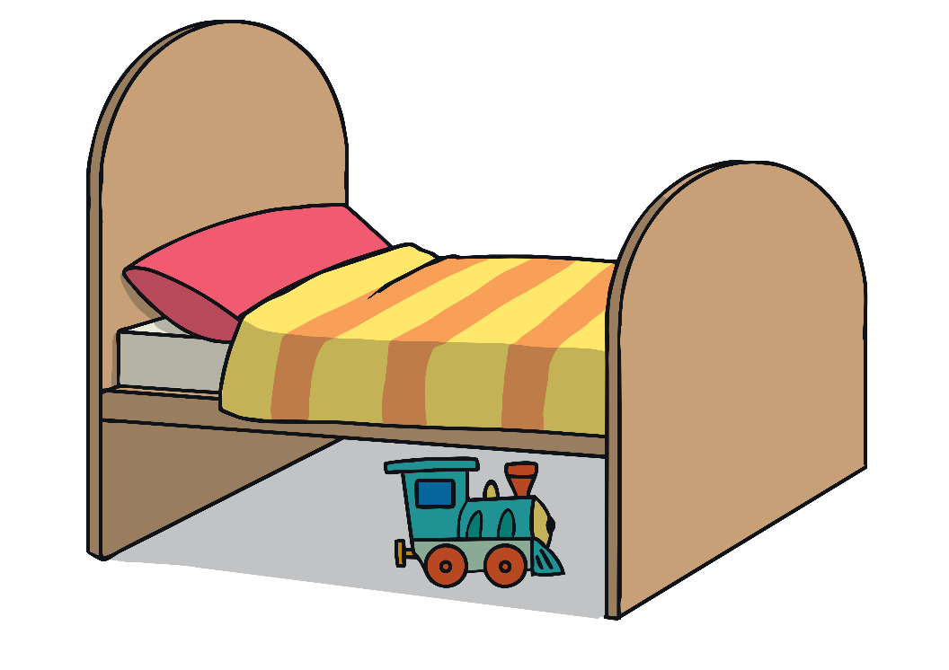



There are also patterns…
In our homes.

Slide 5



Rangoli Patterns
Rangoli Patterns are special because they are symmetrical patterns.
If we draw a line down the middle of the pattern, it looks the same on both sides.

Slide 6
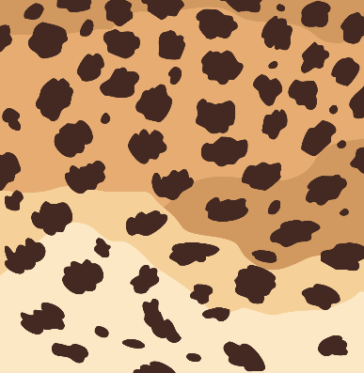


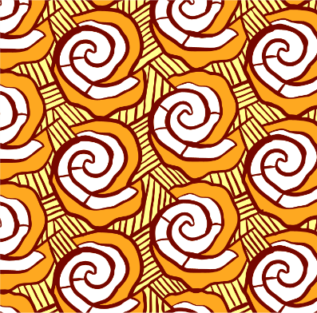


Which are patterns?
Click the squares with patterns inside.
Try
again
Try
again
Try
again

