Slide 2

Roll up, roll up!
Welcome to my new circus!
I need some help to make my circus acts even better. I need to find more or less.
Can you help?

Slide 3
My clown is juggling 4 balls.
He keeps dropping the balls! He needs one fewer ball!
Which number is one less than four?
10
9
I think he will have five balls. Do you agree?
8
7
6
5
4
3
2
1
One less than four is equal to three.
4 - 1 = 3
0

Slide 4
I only have 1 juggler. It’s not enough!
10
I have one juggler. I need three more. How many will I have?
9
How can you be sure? Can you use the number line to prove it?
8
7
6
5
4
3
2
1
Three more than one is equal to four.
1 + 3 = 4
0

Slide 5
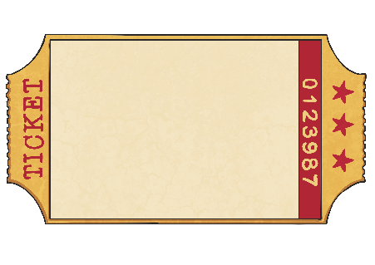

I have sold 2 tickets for the show.
I need to sell three more to make some money!
10
9
I think three more than two is equal to four. Am I correct?
8
7
6
5
4
3
2
1
Three more than two is equal to five.
2 + 3 = 5
0

Slide 6
The acrobat has 9 hoops.
But it’s too many and they keep falling over!
Maybe two fewer hoops would be easier.
10
9
Where do you find the number that is
two less than nine on the number line?
8
7
6
5
4
3
2
1
Two less than nine is equal to seven.
9 - 2 = 7
0

Slide 7
There are 3 funny clowns!
The show would be even funnier if there were three more clowns!
How many would that be?
10
9
Is it the same as double three?
8
7
6
5
4
3
2
1
Three more than three is equal to six.
3 + 3 = 6
0

Slide 8
Thank you for helping me! Come back to my circus soon!

