Slide 1


Science
Forces and Magnets
Year One
Science | Year 3 | Forces and Magnets | Scrapyard Challenge | Lesson 3

Slide 2
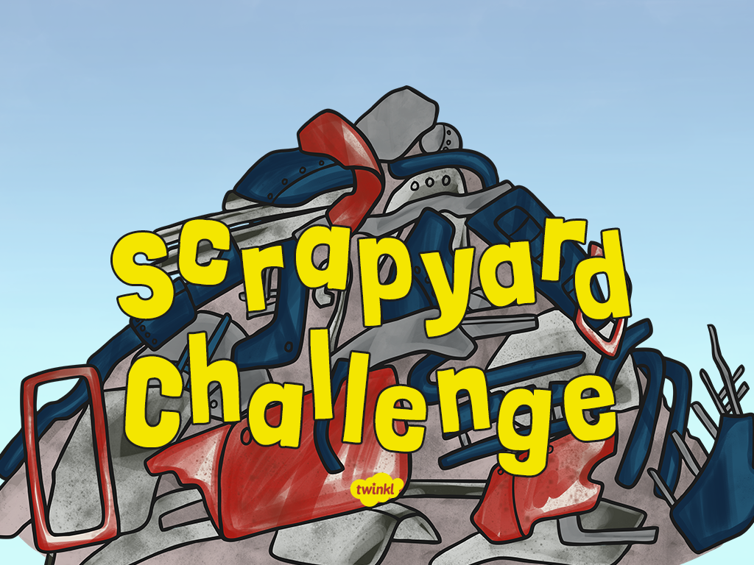

Slide 3
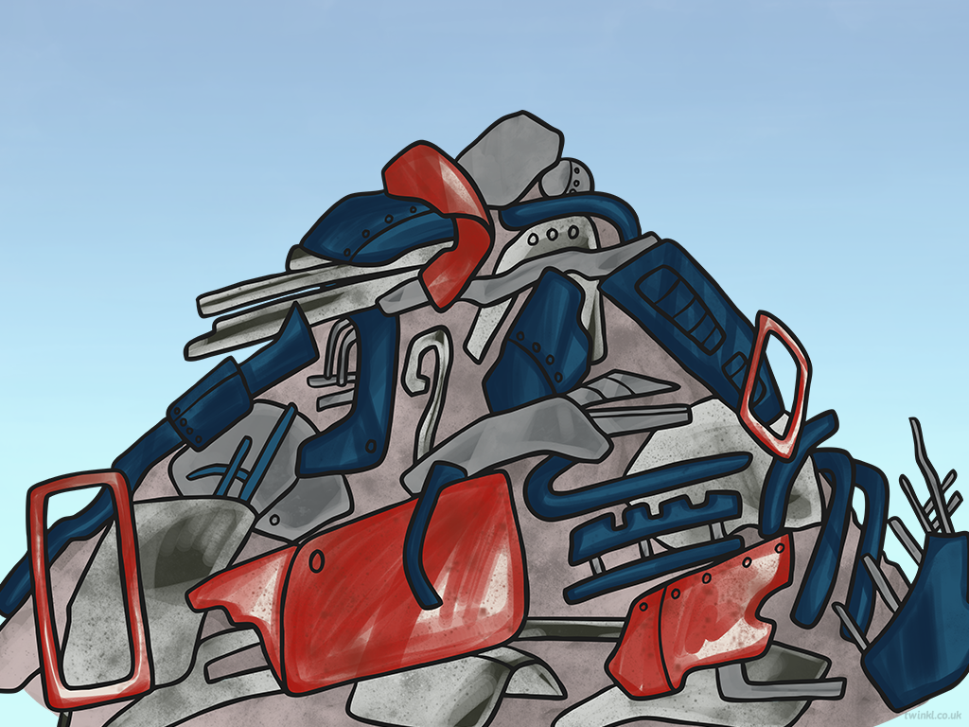
Aim
I can sort magnetic and non-magnetic materials.
Success Criteria
I can explain that magnets produce a force that attracts some materials.
I can use a magnet to separate items that are magnetic and non-magnetic.
I can name some magnetic materials and some non-magnetic materials.

Slide 4

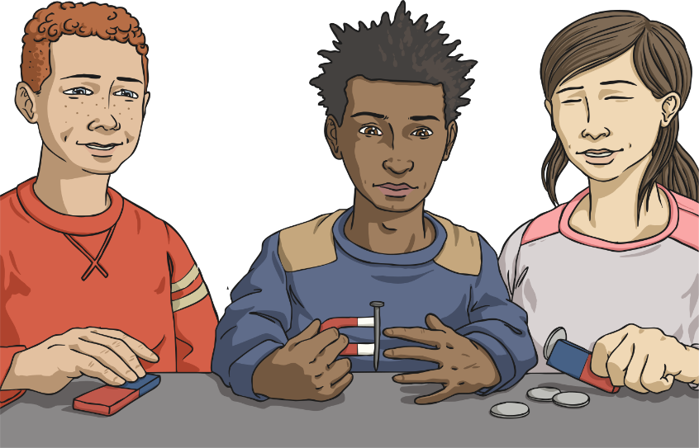
Who Is Right?
These children are using a magnet to pick up different objects.
They are talking about what magnets are and how they work.
Which child's ideas do you agree with?
I think the magnet produces a force to pull the different objects onto it.
I think the magnet is sticky. It has some special glue on it to make things stick to it. This is how we can pick things up using the magnet.
I think magnets are special objects that connect to any other object.

Slide 5
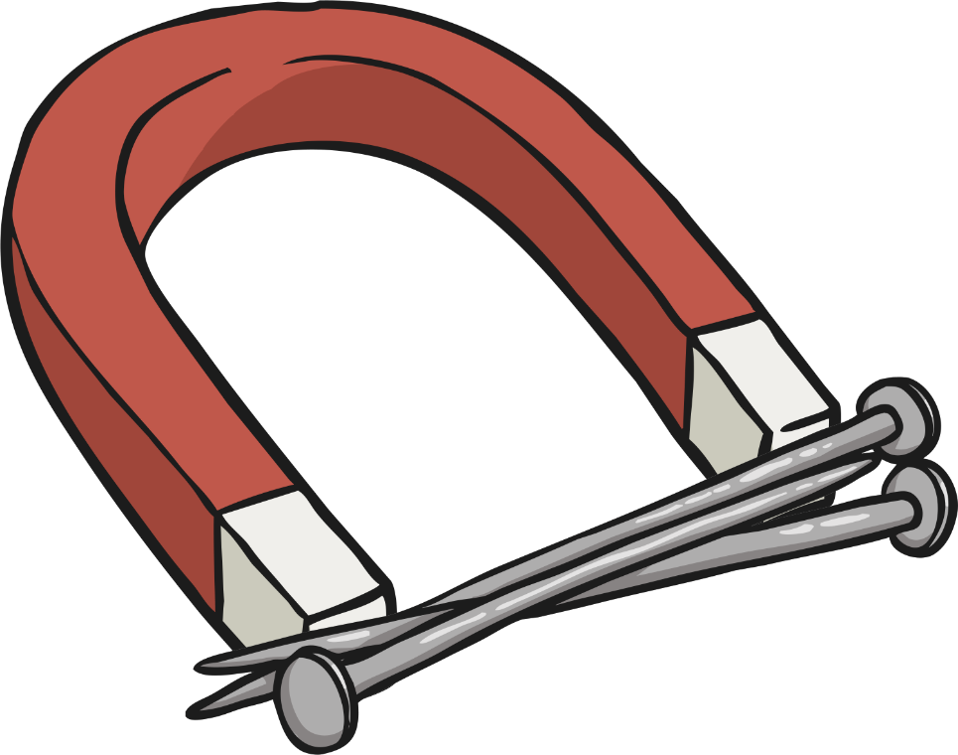
What Is a Magnet?
A magnet is a special type of object. It produces an area of magnetic force around itself, called a magnetic field.
If certain materials enter this magnetic field, they will be attracted to the magnet. This will cause the materials to be pulled towards the magnet.
Try it! Move a magnet slowly towards a steel paper clip. As the paper clip enters the magnetic field around the magnet, it will 'jump' towards the magnet.

Slide 6

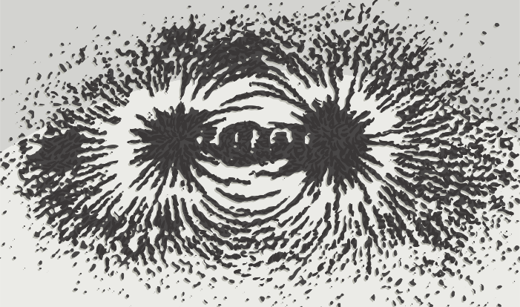
Seeing the Magnetic Field
A magnetic field is the area around a magnet that produces a pulling force on certain materials. The magnetic field is invisible, so we can't see it.
Try this activity to detect where a magnet's magnetic field is, and what shape it is:
Place a bar magnet in the centre of a tray, and place a piece of paper on top of the magnet.
Sprinkle a few iron filings onto the paper from a few centimetres above it.
Keep sprinkling small amounts of iron filings onto the paper until you can see the lines of the magnetic field.
If you are at home, watch this video https://www.youtube.com/watch?v=LMFAOLKaYd0

Slide 7
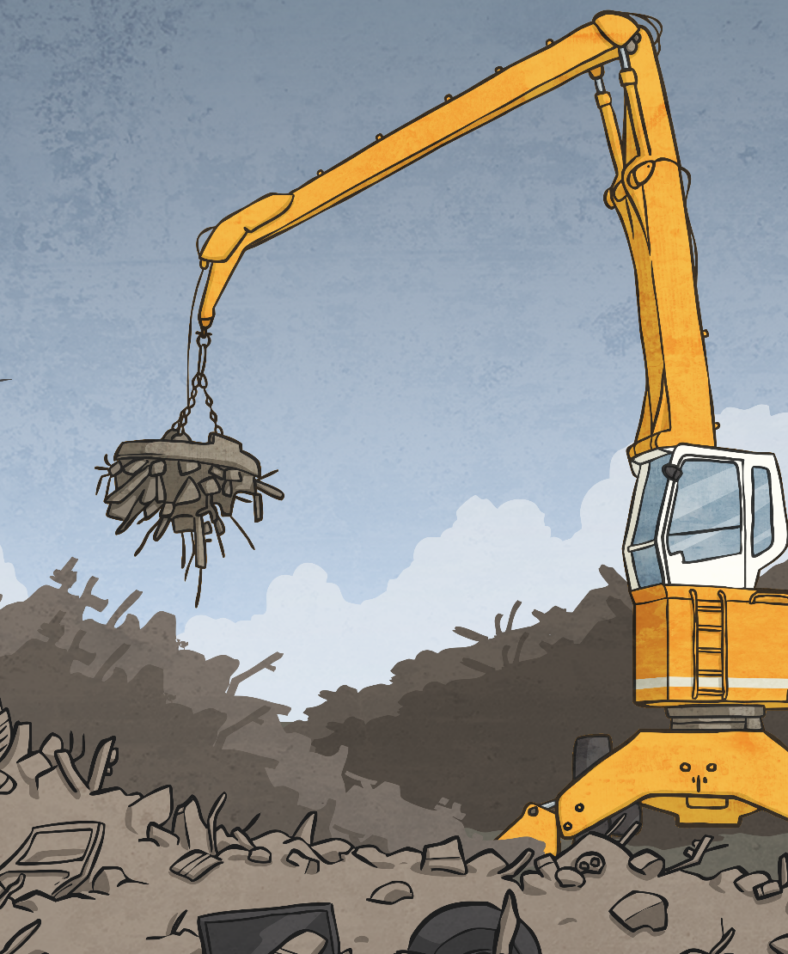
Magnets at the Scrapyard
At a scrapyard, metals can be separated by using magnets. The metal materials travel along a conveyor belt and are separated by a giant turning magnet. The picture shows another magnet you might see at a scrapyard. There is a huge plate magnet at the base of the crane. Metals
that are magnetic are pulled towards this powerful magnet. Non-magnetic metals are not.
Watch this clip to see a scrapyard in action! https://www.bbc.co.uk/bitesize/clips/zcntsbk

Slide 8
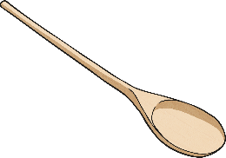
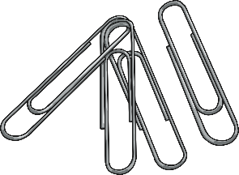
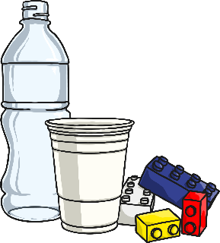
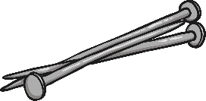

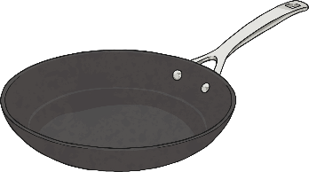
Magnets at the Scrapyard
The magnets in the scrapyard sorted the magnetic materials from the non-magnetic materials.
Magnetic materials are attracted to magnets. This means the material will be pulled towards a magnet.
Non-magnetic materials are not attracted to magnets. This means the material will not be pulled towards a magnet.
But which materials are magnetic and which ones aren't?

Slide 9

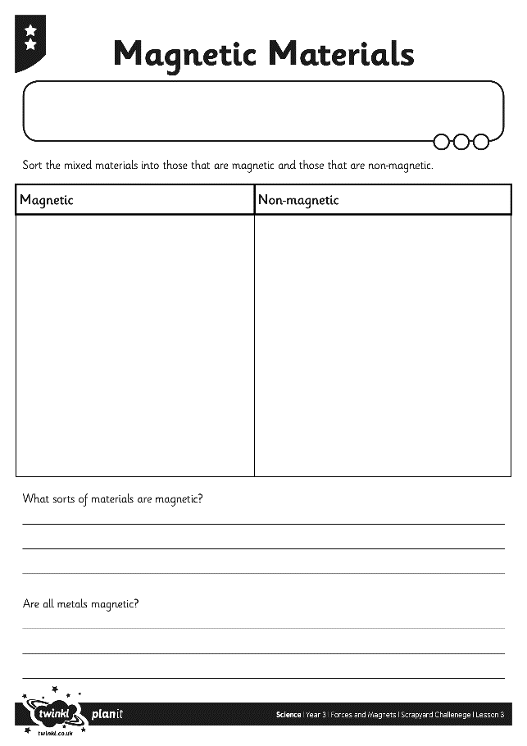
Magnetic Materials
Imagine that you are in charge of a scrapyard like the one in the clip you have just watched. You have a big jumble of materials to sort out, and you need to separate the magnetic materials from the non-magnetic materials.
Use a magnet to attract materials, and remove them from the pile.
Any materials that are left in the pile are non-magnetic.
Record your findings on your Magnetic Materials Activity Sheet.

