Slide 1
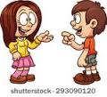
Active
and passive verbs
What was said just now?

Slide 2
Subject and object (revision)
What is the subject of each of these sentences?
The dog barked.
The dog bit me.
I bit the dog.
You must get off the bus.
This bus goes to Leeds.
I am a dog.
The dog barked.
The dog bit me.
I bit the dog.
You must get off the bus.
This bus goes to Leeds.
I am a dog.
Note: the subject isn’t always a person: The tree fell on Andi.

Slide 3
Subject and object (revision)
What is the object of each of these sentences? Do they all have an object?
The dog barked.
The dog bit me.
I bit the dog.
You must go to Leeds on the bus.
I’m sharpening my pencil.
Get a new pencil.
The dog barked.
The dog bit me.
I bit the dog.
You must go to Leeds on the bus.
I’m sharpening my pencil.
Get a new pencil.

Slide 4

Have a think...
Every sentence must have a subject.
True or false?
If you think it’s false, give an example of a correctly formed sentence which has no subject.
We sometimes use very short sentences where there is no subject or object, for example:
Yes / No
What about this sentence:
The cheese was eaten.

Slide 5

Have a think...
Every sentence must have an object.
True or false?
If you think it’s false, give an example of a correctly formed sentence which has no object.
As before, one word sentences might not have a subject or an object:
Yes / No
What about this imperative sentence?
Watch out!

Slide 6
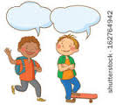
All in order…
object - subject - verb :
What is their usual order in an English sentence?
Subject
Verb
Object
Sentences written like this are in the active voice

Slide 7
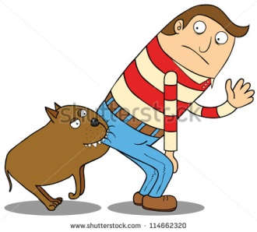
Passive voice
The passive voice lets us use the object of the action as the subject of the sentence.
You might also see it explained this way:
The object of the sentence acts on the subject.
Or:
The object of the sentence moves to the usual subject position.
The dog bit me. (active verb)
I was bitten by the dog. (passive verb)

Slide 8
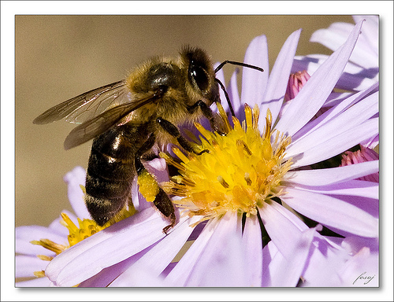
Turn these active verb sentences into passive verb sentences:
Bees make honey.
Honey is …
The sun warmed and dried him.
A passing herd of buffalo nearly flattened us.
A projecting ledge of rock broke my fall.
Honey is made by bees.
He was warmed and dried by the sun.
We were nearly flattened by a passing herd of buffalo.
My fall was broken by a projecting ledge of rock.

Slide 9
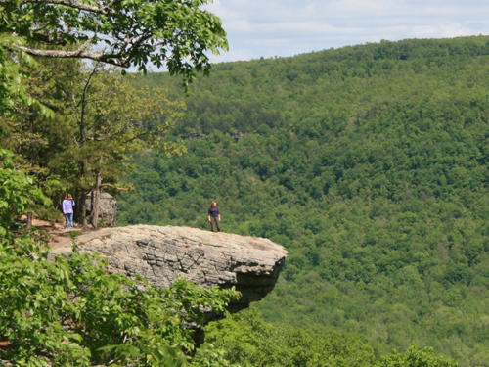
Turn these passive verb sentences into active verb sentences:
My fall was broken by a projecting ledge of rock.
The robbers were seen by a member of the public.
A projecting ledge of rock broke my fall.
A member of the public saw the robbers.

Slide 10
Grammar nerds’ corner
Passive verbs can be in any tense: past, present, future and so on.
That’s why it is not called the passive “tense” but the passive voice of the verb.
Examples: It amuses me – present tense, active voice.
I am amused – present tense, passive voice.
I was amused – past tense, passive voice.

Slide 11
Identify the tense and voice of the verbs in these sentences:
I missed the bus yesterday.
John will be asked to leave.
My hamster eats too much.
My hamster was eaten by the cat.
My ears were assailed by a howling noise.
The dog was howling.

Slide 12
Style tips: (1) Don’t overdo it!
What is this writer trying to say?
It is noted that your vehicle has been reported to have been parked improperly and you have consequently been issued with a penalty of £40 which must be paid in full within 30 days.
In plain English, this writer is saying four things:
1. You parked in the wrong place.
2. We are fining you £40.
3. Please pay within 30 days.
4. I am a pompous bureaucrat.

Slide 13

Style tips: (2) Use “be”, not “get”
In spoken
English, you
can hear
people
saying
things like:
“We got nicked,” or “That’s how these things get done.”
That’s OK in informal speech – but don’t use it in your writing, except in dialogue.
In standard written English, we use the auxiliary verb (helping verb) “to be” to form the passive voice.
Not “to get”.

Slide 14
Rewrite these sentences, using the correct form of the passive voice for standard written English:
I got stung by a wasp.
Plants get pollinated by insects.
Proteins get broken down by enzymes in our guts.
Trespassers will get prosecuted.

