Slide 1


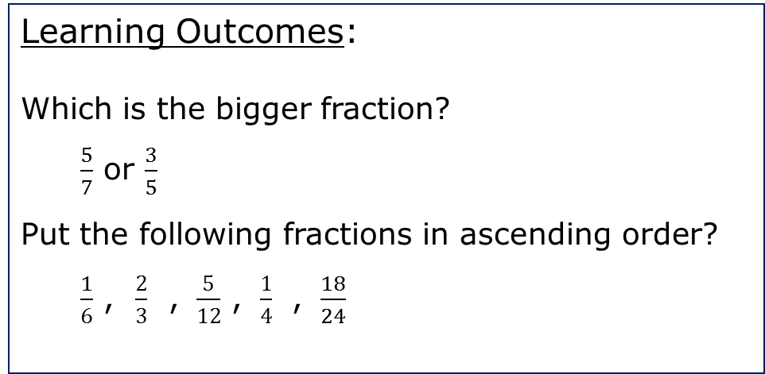
WALT…
Comparing and ordering fractions (different denominators)
Where are we in our learning journey?
Learning Outcomes:
Which is the bigger fraction?
  $\frac{5}{7}$ or $\frac{3}{5}$
Put the following fractions in ascending order?
  $\frac{1}{6}$ , $\frac{2}{3}$ , $\frac{5}{12}$ , $\frac{1}{4}$ , $\frac{18}{24}$
Keyword(s)…
Parts
Whole
Numerator
Denominator

Slide 2
RECAP
Compare these fractions, using <, > or =
7
>
3
16
16
11
11
>
20
18

Slide 3
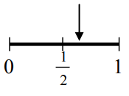
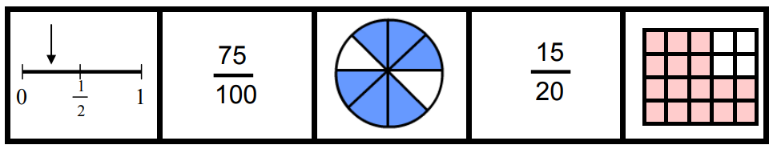
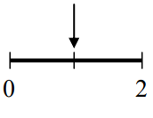

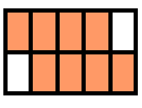
EXPLORE
Which diagram doesn’t have a pair?
2
3
4
5
3
4
3
4
4
5

Slide 4
QUESTION
Compare these fractions, using <, > or =
Can you explain why and fill in the blank?
2
5
5
6
<
>
6
12
6
8
How can we compare fractions without using a diagram?

Slide 5
DEFINE
Fractions can be compared more easily by making the denominators the same.
Find the common denominator
Multiply fractions to make the denominators the same
Compare the numerators. If the numerator is bigger then the fraction is bigger.

Slide 6


EXAMPLE
Compare these fractions：
Common denominator：8 and 12 both go into 24
3
5
>
8
12
Make denominators the same：
8 needs to be multiplied by 3
12 needs to be multiplied by 2
$$×\frac{2}{2}$$
$$×\frac{3}{3}$$
9
>
10
24
24
Compare numerators：10 is bigger than 9 therefore 5/12 is bigger than 3/8

Slide 7


EXAMPLE
Compare these fractions：
Common denominator：9 and 6 both go into 18
8
>
5
9
6
Make denominators the same：
9 needs to be multiplied by 2
6 needs to be multiplied by 3
$$×\frac{3}{3}$$
$$×\frac{2}{2}$$
16
15
>
18
18
Compare numerators：16 is bigger than 15 therefore 8/9 is bigger than 5/6

Slide 8


CHECK
3
>
5
4
6
$$×\frac{2}{2}$$
$$×\frac{3}{3}$$
9
10
>
12
12

Slide 9

CHECK
3
>
1
7
3
$$×\frac{7}{7}$$
$$×\frac{3}{3}$$
9
>
7
21
21

Slide 10
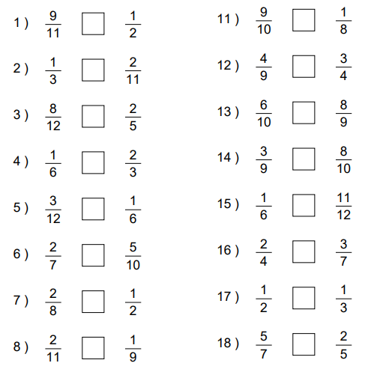
EXERCISE

Slide 11
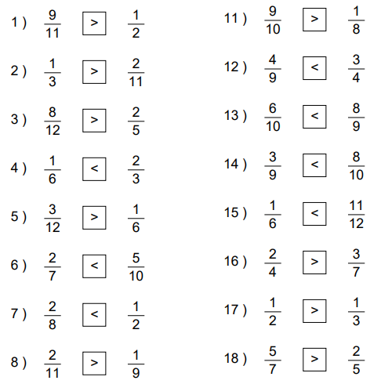
ANSWERS

Slide 12
DEFINE
Fractions can also be compared by putting them in order.
Ascending means from smallest to biggest.
Descending means from biggest to smallest.

Slide 13




EXAMPLE
Put the following fractions in ascending order:
3
5
7
The common denominator is 24.
Each fraction needs to then be converted so that all the denominators are the same.
The numerators can then be compared.
4
4
6
8
12
$$×\frac{6}{6}$$
$$×\frac{4}{4}$$
$$×\frac{3}{3}$$
$$×\frac{2}{2}$$
18
16
15
14
24
24
24
24
7
5
4
3
>
>
>
12
8
6
4

Slide 14


EXAMPLE
Put the following fractions in descending order:
1
1
2
The common denominator is 18.
Each fraction needs to then be converted so that all the denominators are the same.
The numerators can then be compared.
1
1
6
3
18
9
$$×\frac{3}{3}$$
$$×\frac{6}{6}$$
$$×\frac{2}{2}$$
3
6
19
4
18
18
18
18
1
1
2
1
1
>
>
>
18
3
9
6

Slide 15
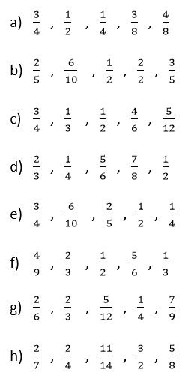
EXERCISE
Put the following fractions in ascending order:

Slide 16
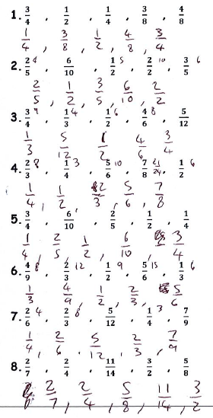
ANSWERS

Slide 17
EXIT TICKET
Put the following fractions in descending order:
13
19
10
4
6
16
24
12
6
8
39
38
40
32
36
48
48
48
48
48
10
13
19
6
4
>
>
>
>
12
16
24
8
6

Slide 18



REFLECTION
What have you learnt today?
.
I don’t understand
I need more practice!
I fully understand
What Went Well?
Even Better If?
Think about how you can improve your learning

