Slide 1
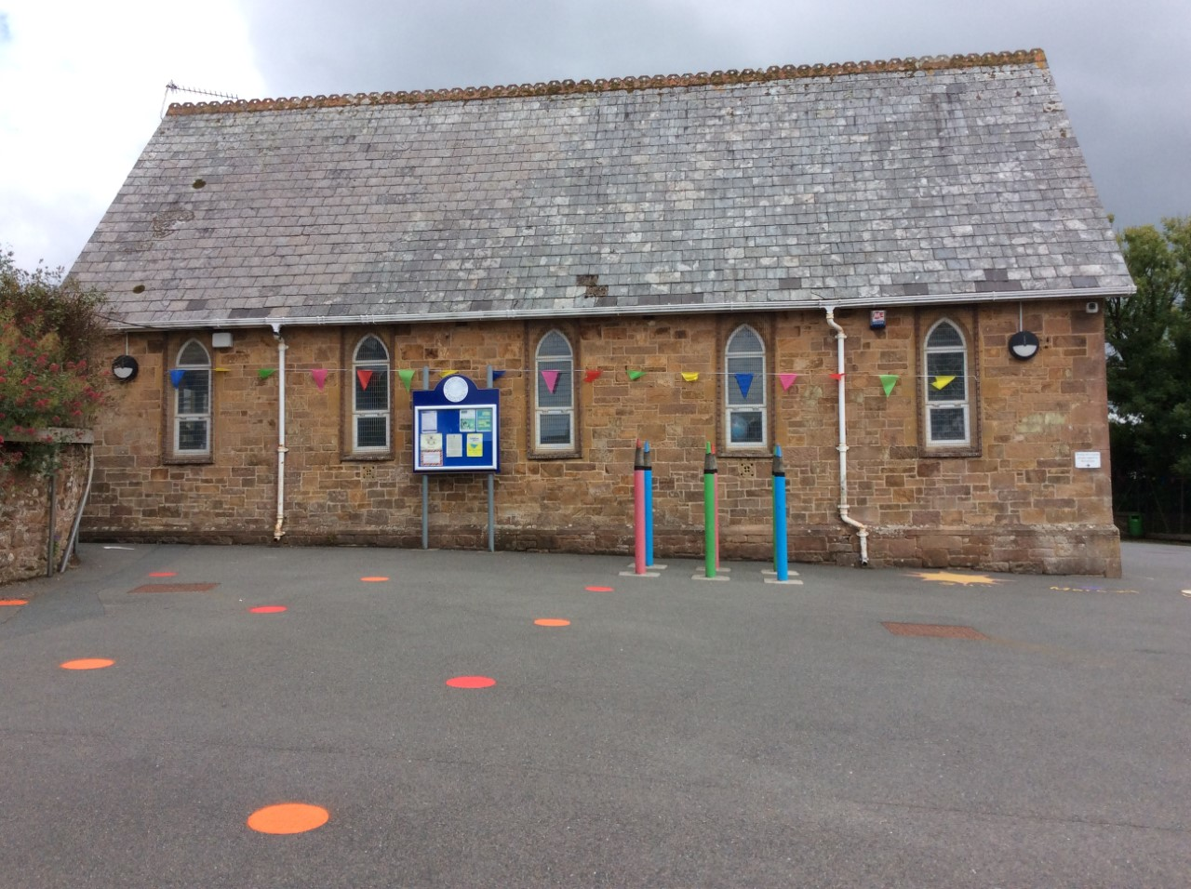
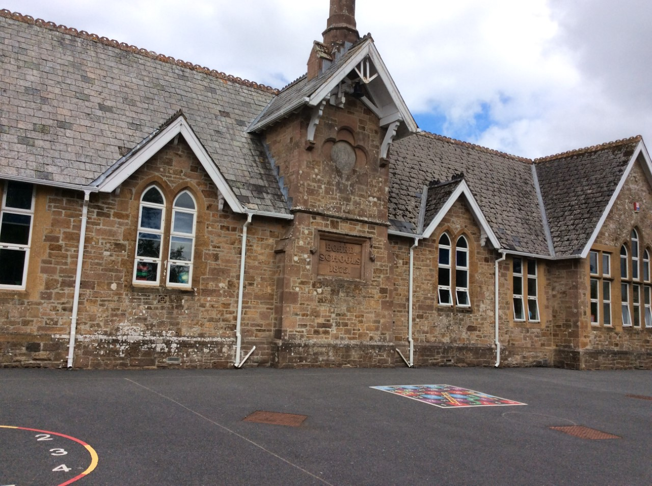
Welcome To Hatherleigh Community Primary School.

Slide 2
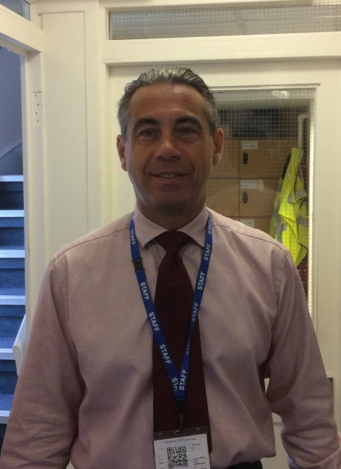
Mr Monger is the Head Teacher.

Slide 3
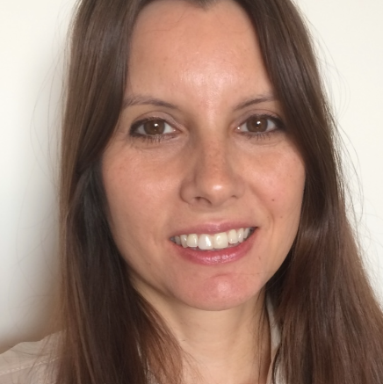
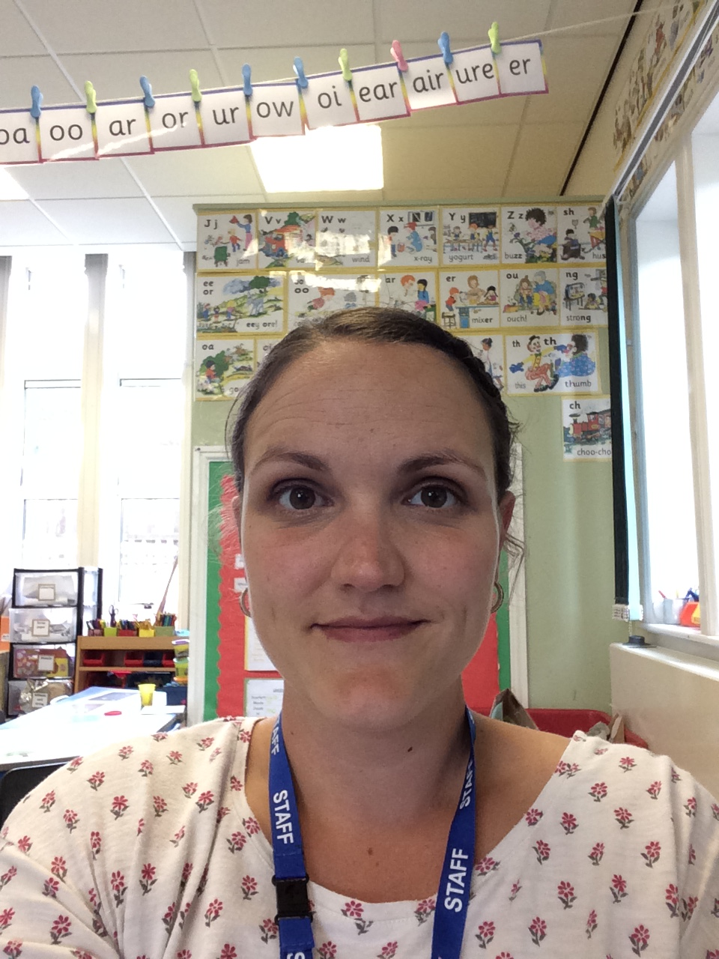
Your class teachers are Miss Tucker (Mon-Thurs) and Mrs Byers (Fri)
Miss Tucker
Mrs Byers

Slide 4



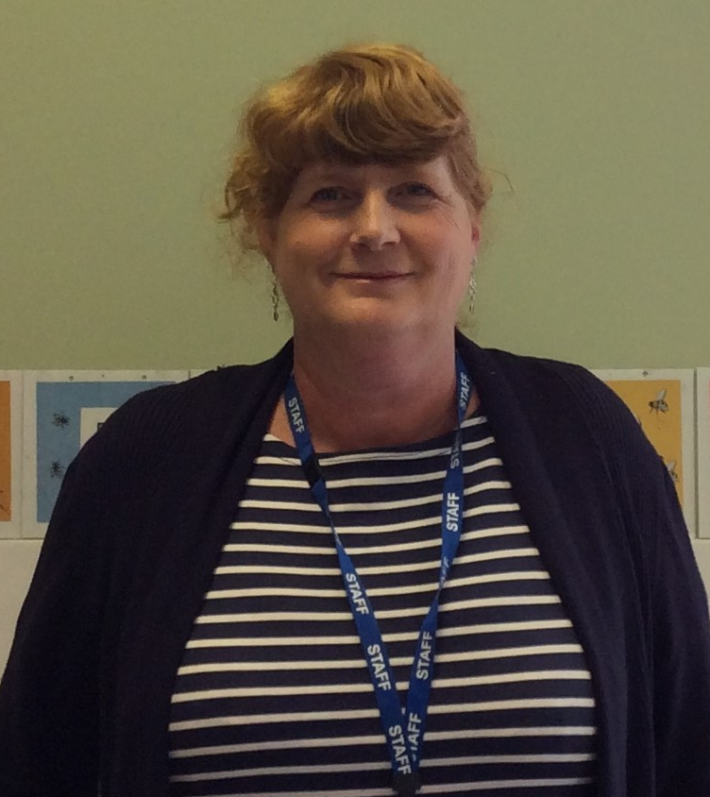


Sarah is our wonderful teaching assistant

Slide 5
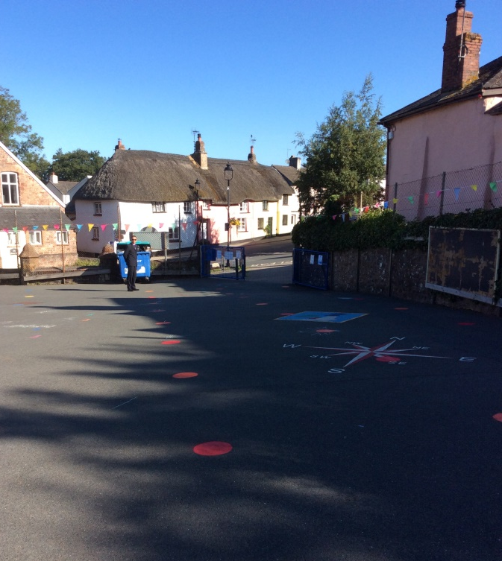
Arriving and leaving.
You can arrive at school between 8:45am-8:55am. An adult will be on the school gate to greet you and you can walk straight into class. Initially your teacher will walk you in.
At the end of the day we line up at the gate and see the children out one by one at 3:25pm.

Slide 6
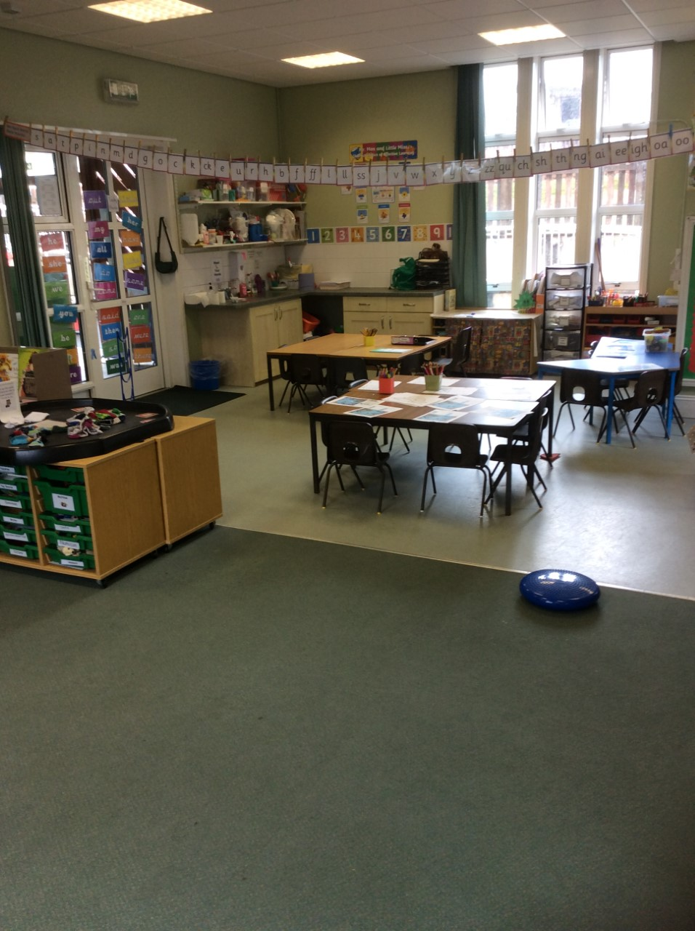
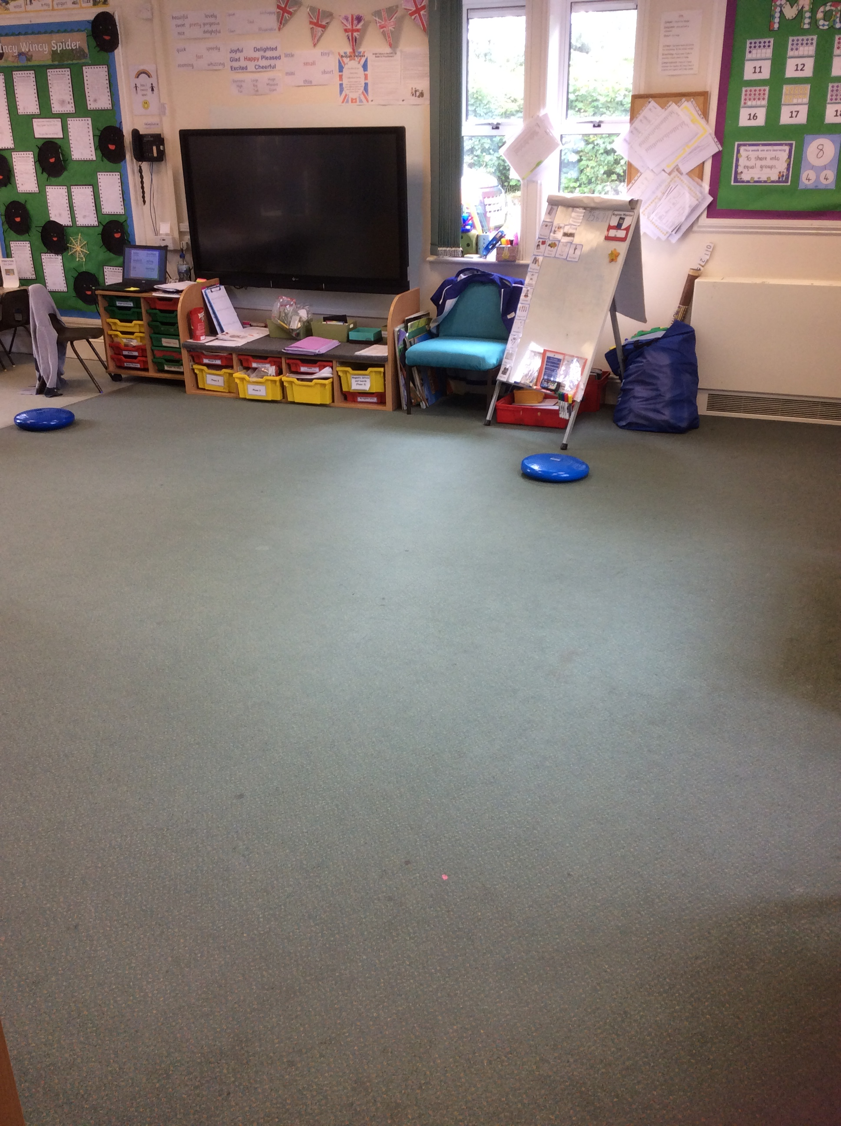
The Chestnut Classroom.
We have tables but we also have lots of space to play on the carpet. We move things around regularly to meet our needs.

Slide 7
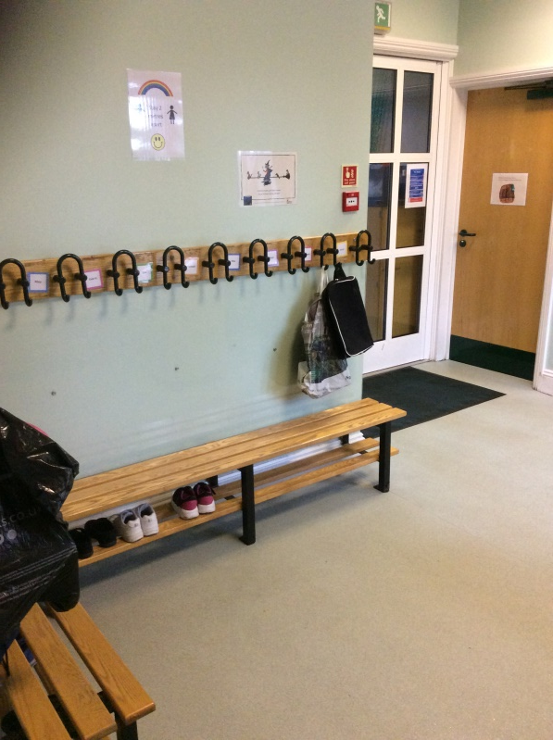
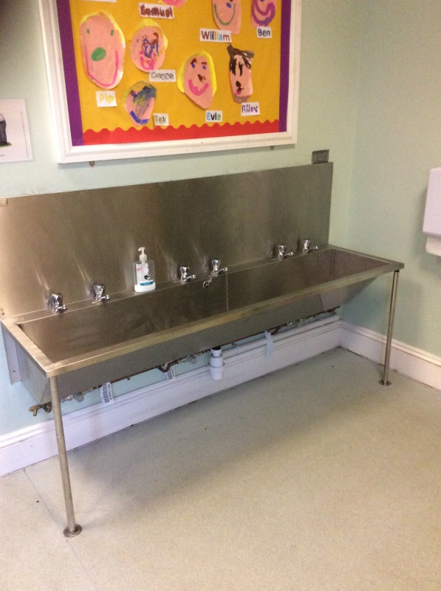
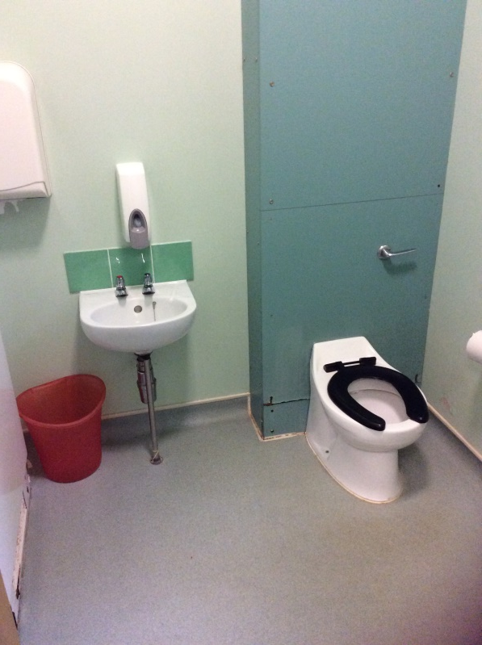
The Cloakroom and Toilets.
You will have a peg to hang your coat and bag on. We have two toilets and a big sink.

Slide 8
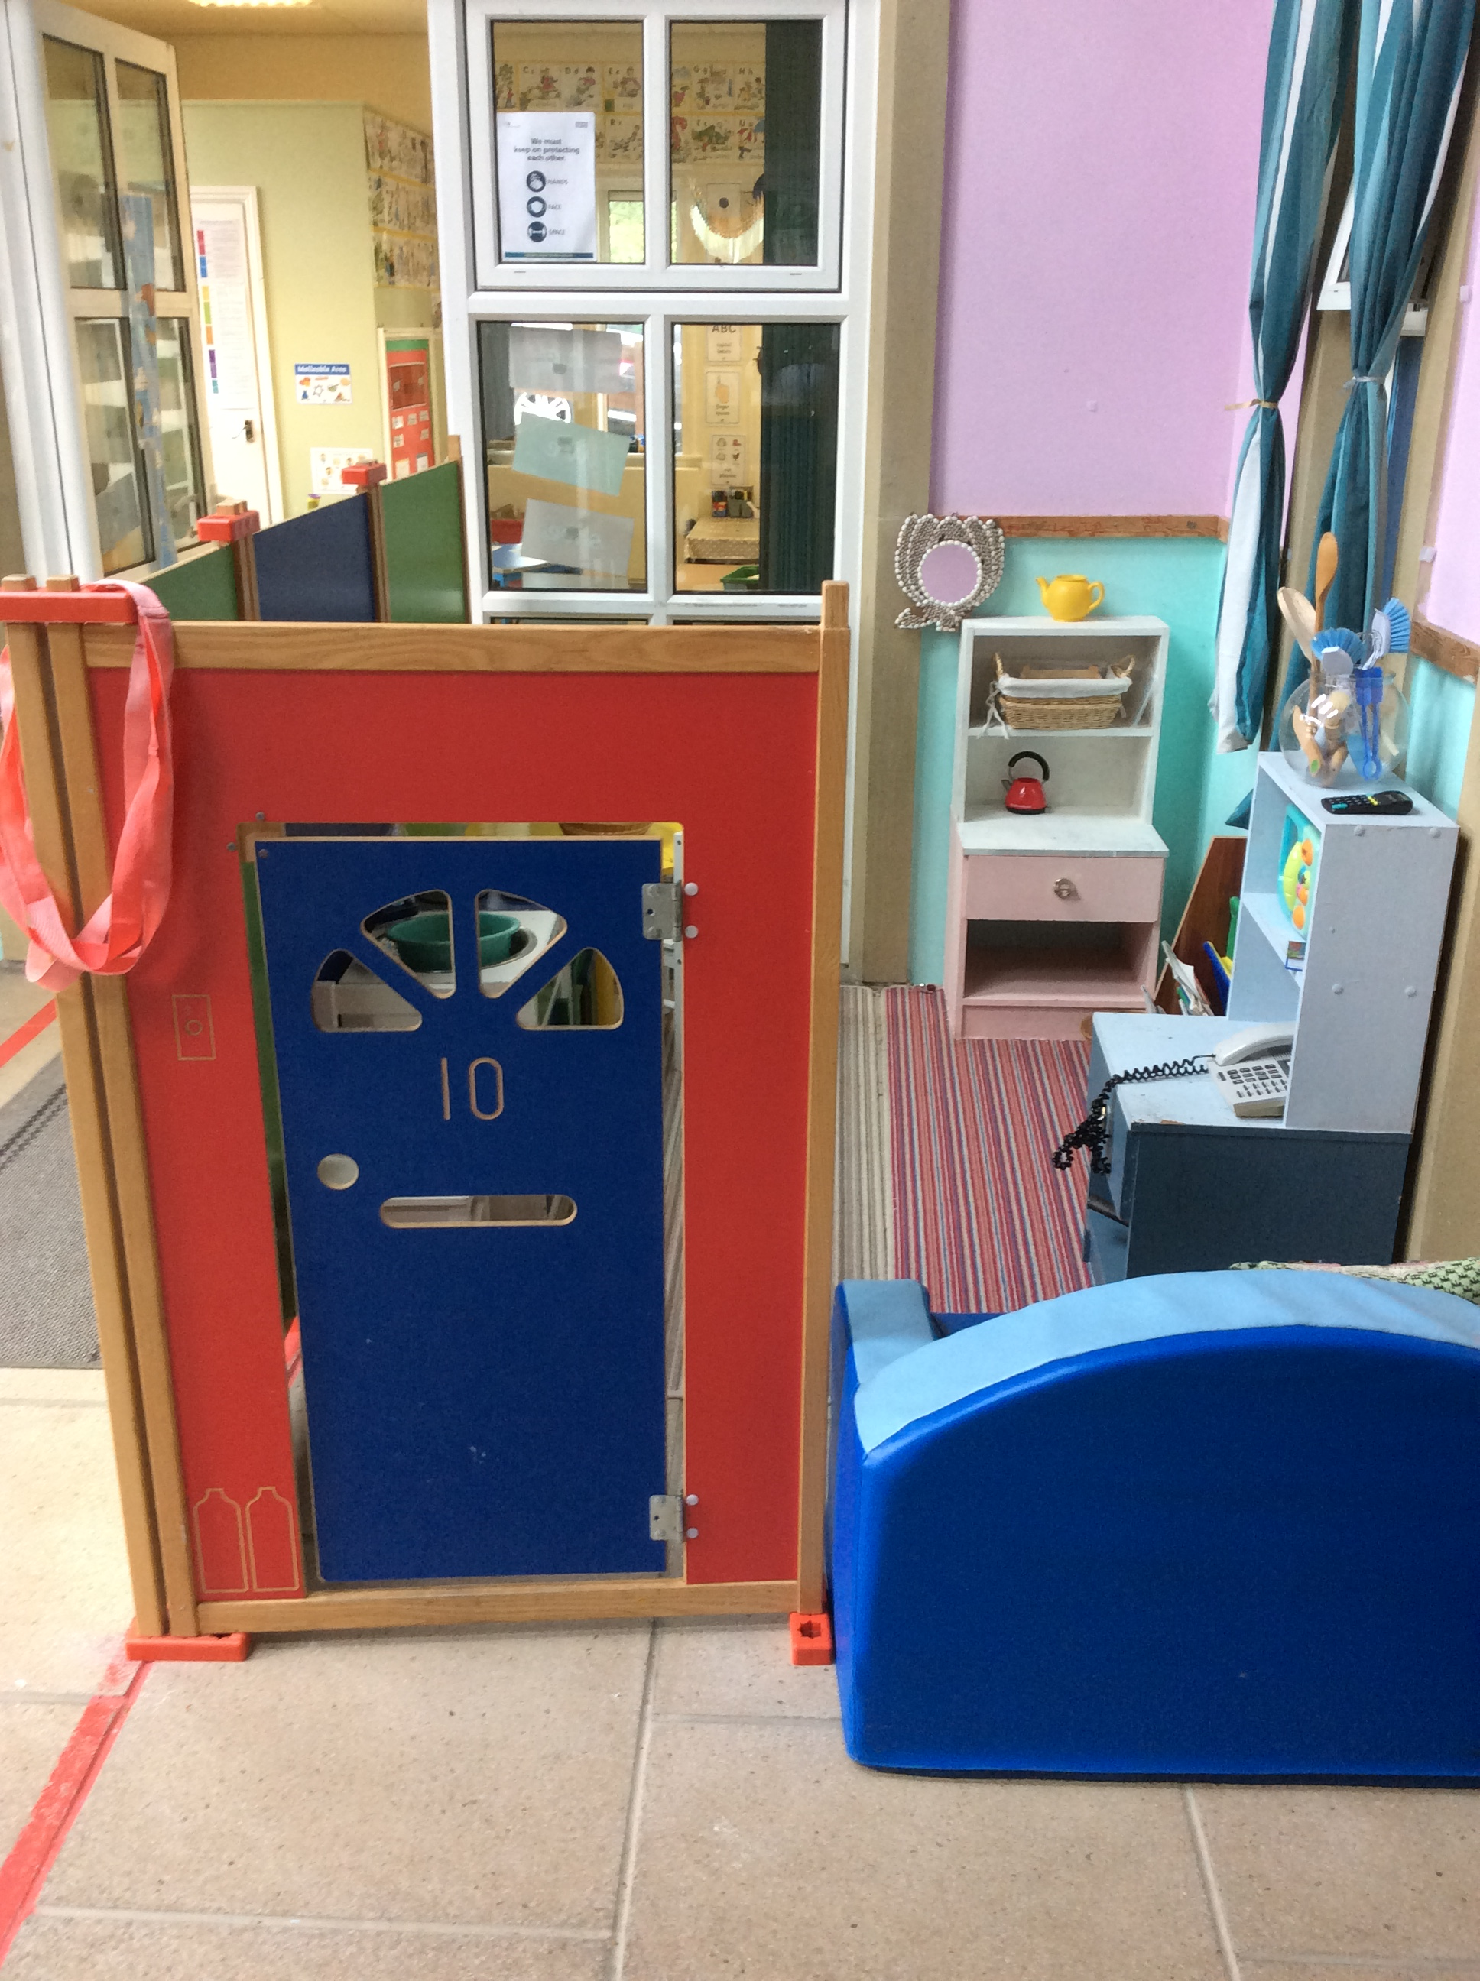
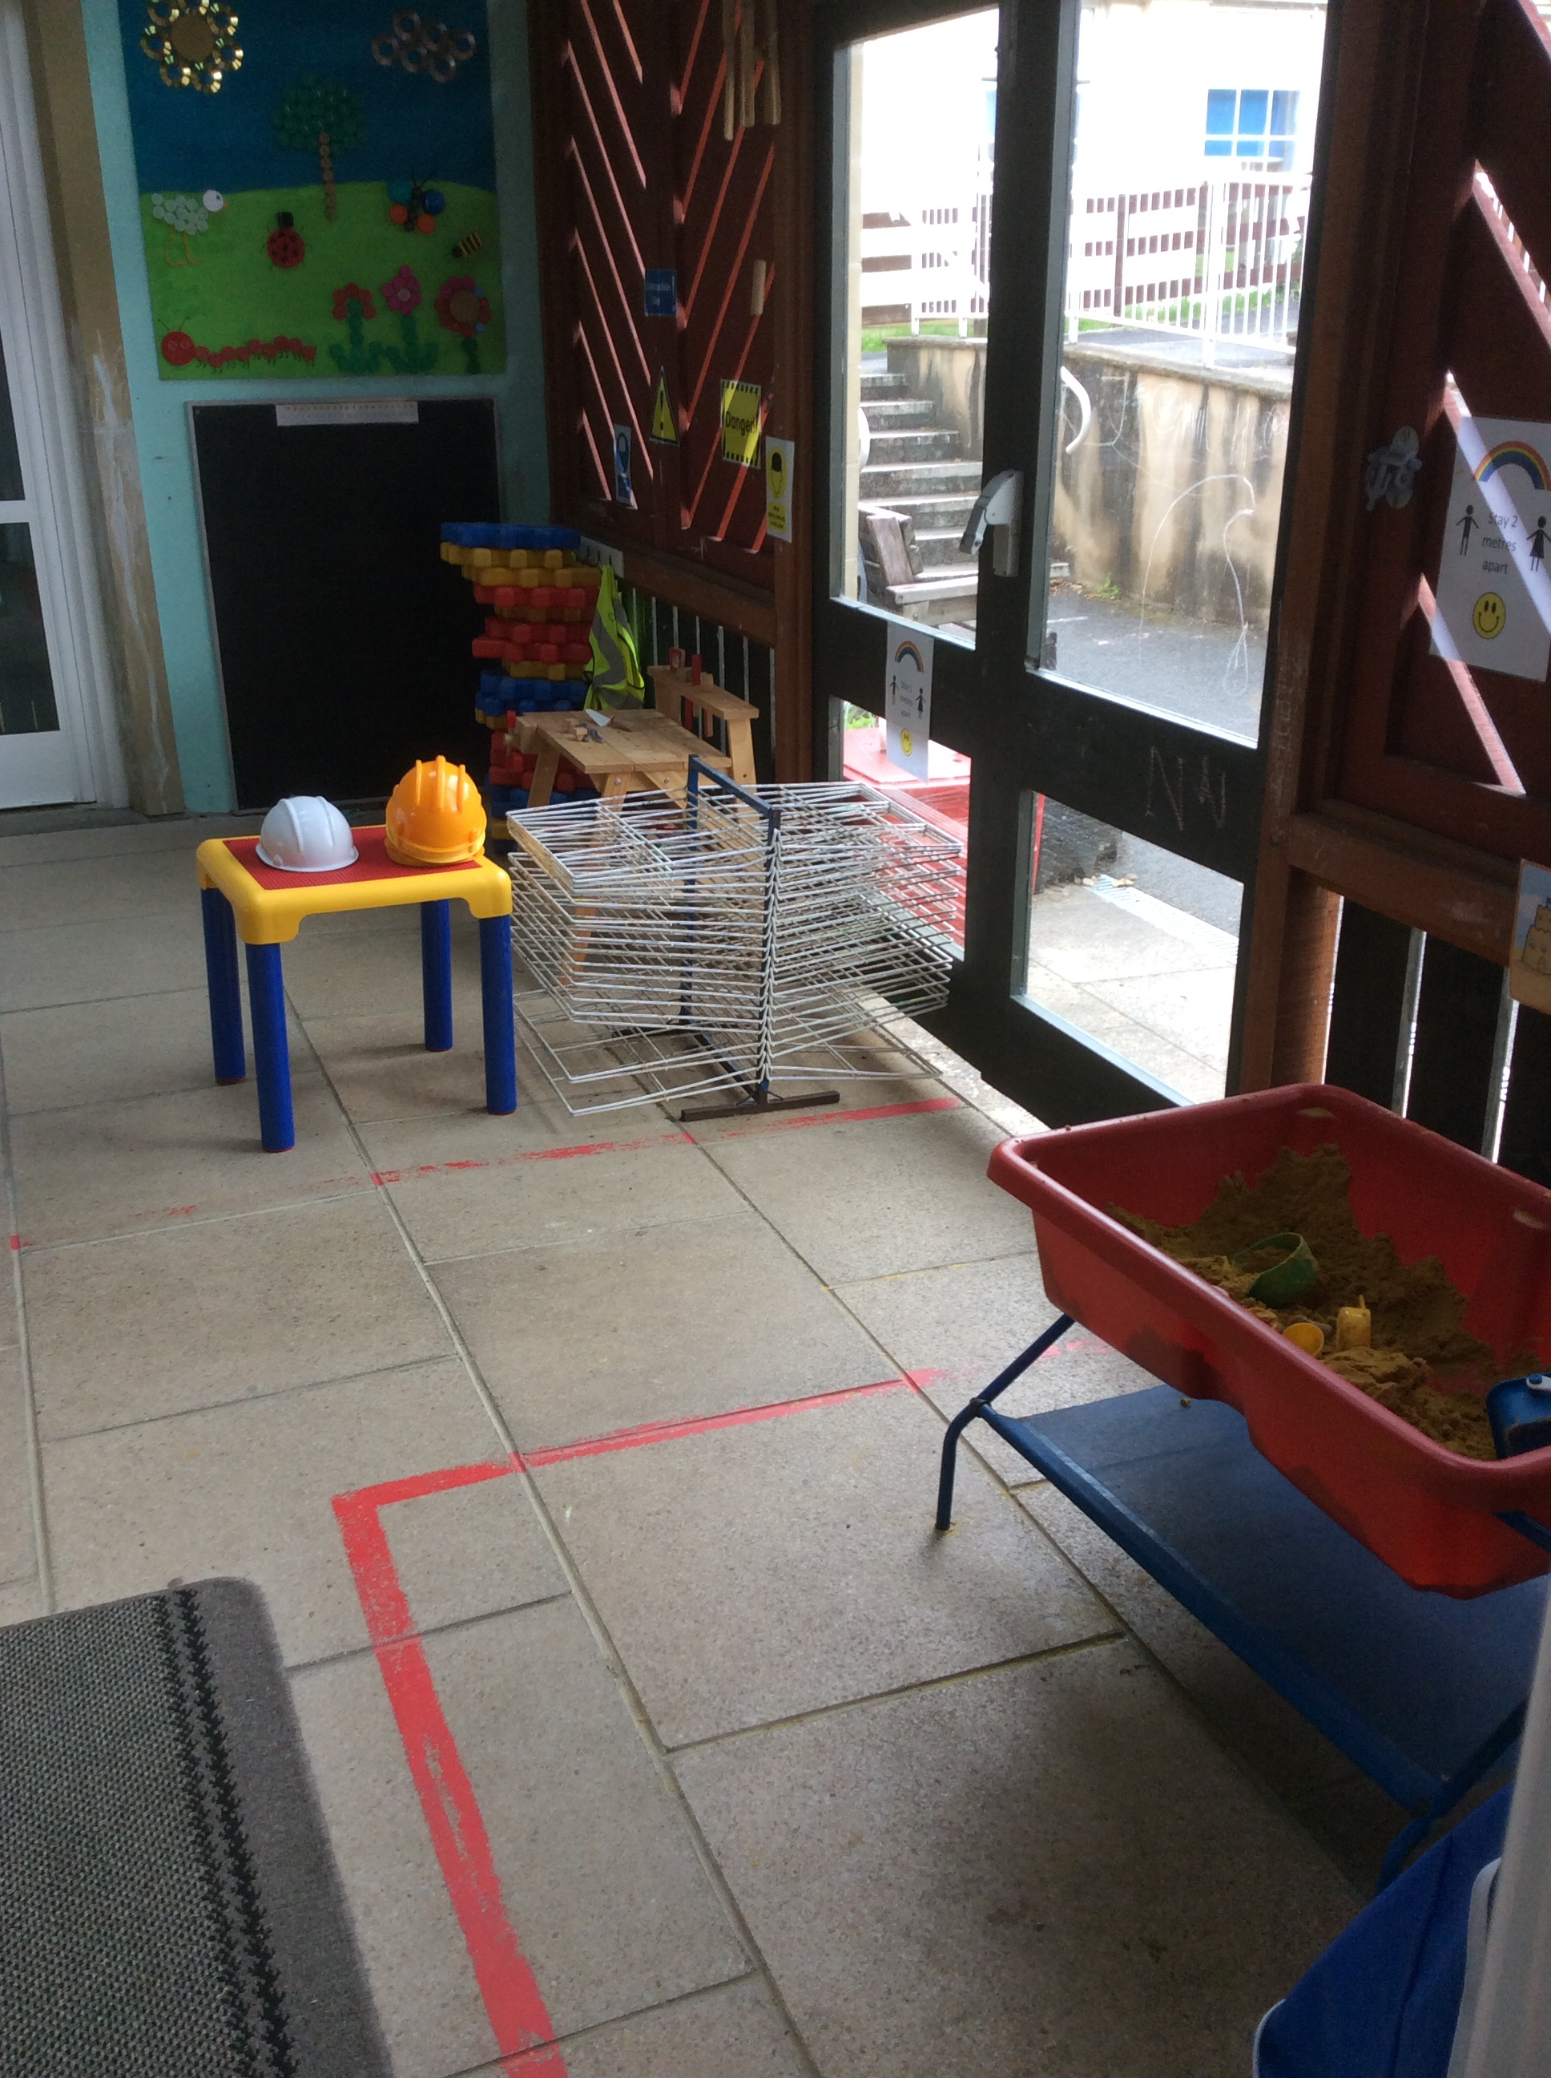
We have a covered play space attached to the classroom. This is where our sand, water and some of the bigger equipment is kept.

Slide 9
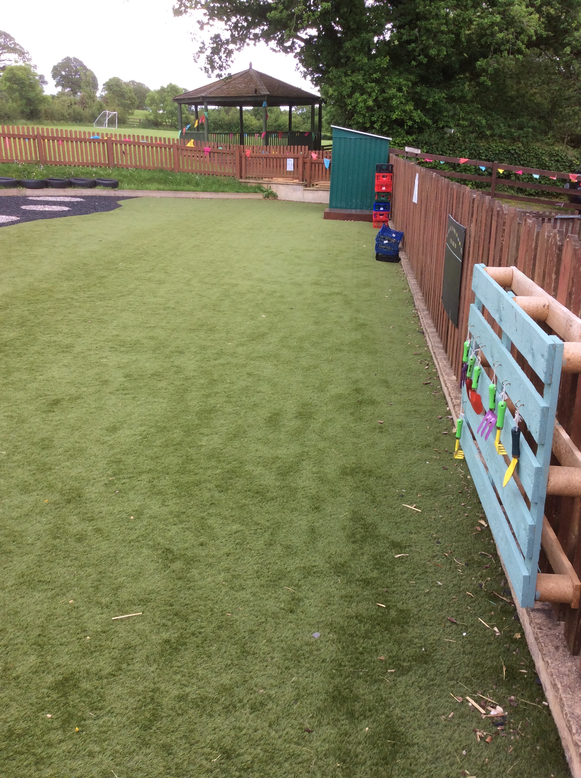
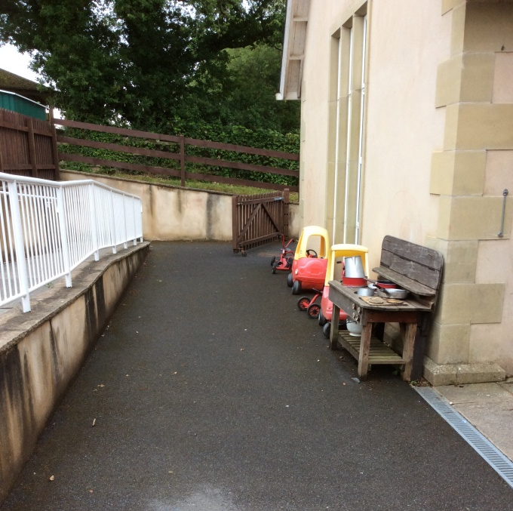
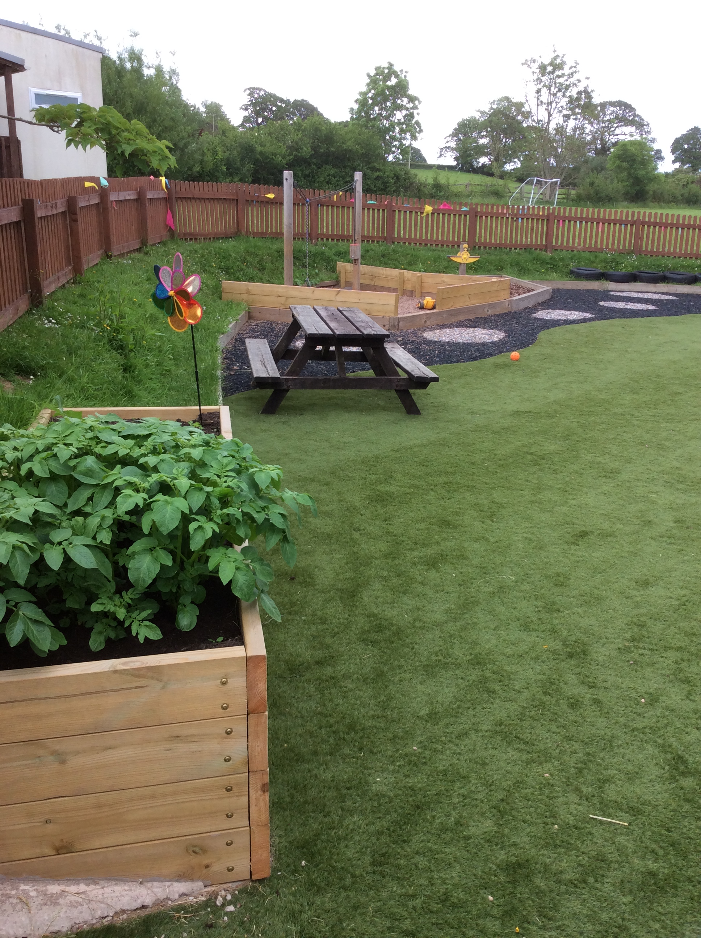
Our outdoor Learning Spaces.
We have scooters, cars, bikes and trikes.
Our water tray is out here when the weather is nice.
We have a plater to grow our own plants and vegetables.

Slide 10
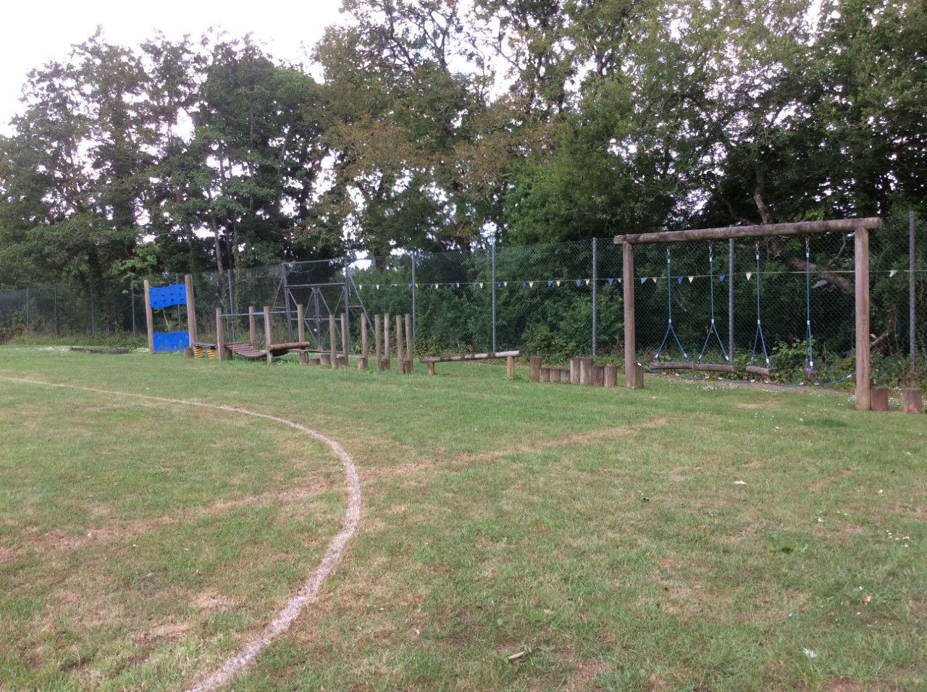
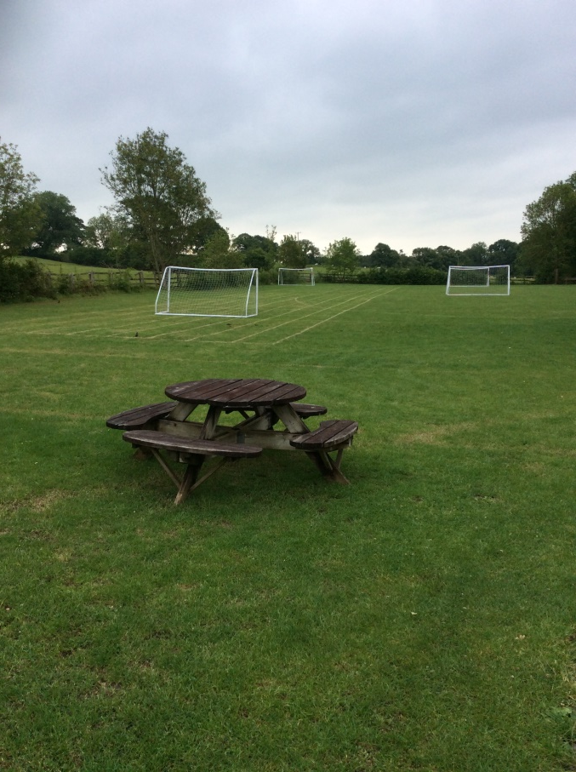
The Playing Field.

Slide 11
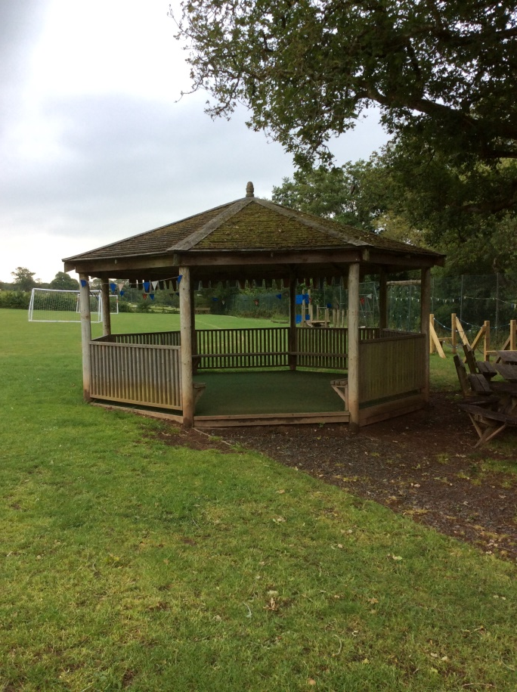
The Outdoor Classroom.

Slide 12
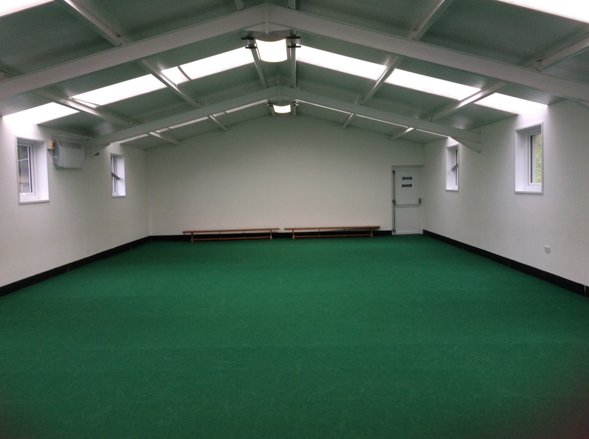
The Morgan Hall - This is where we have assembly and sometimes do PE. We do PE outside when the weather allows.

Slide 13
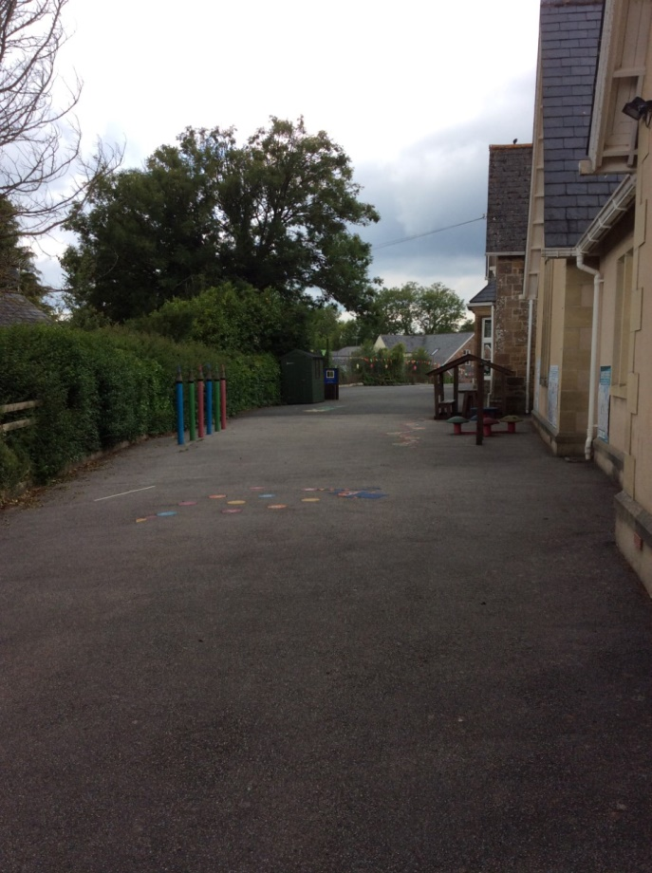
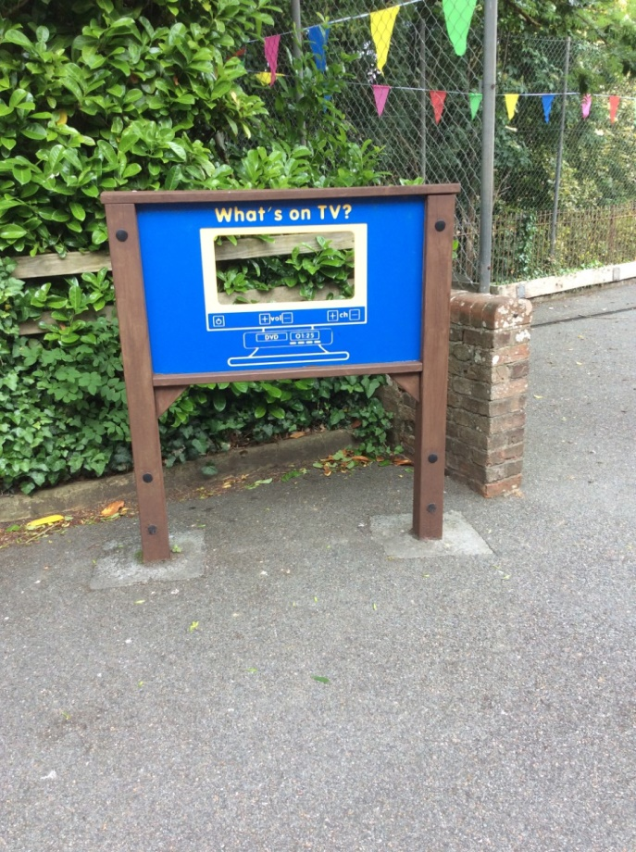
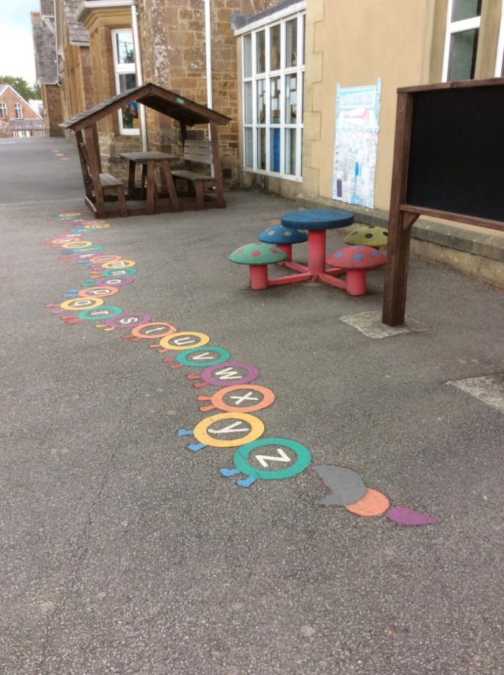
The Playground.

Slide 14
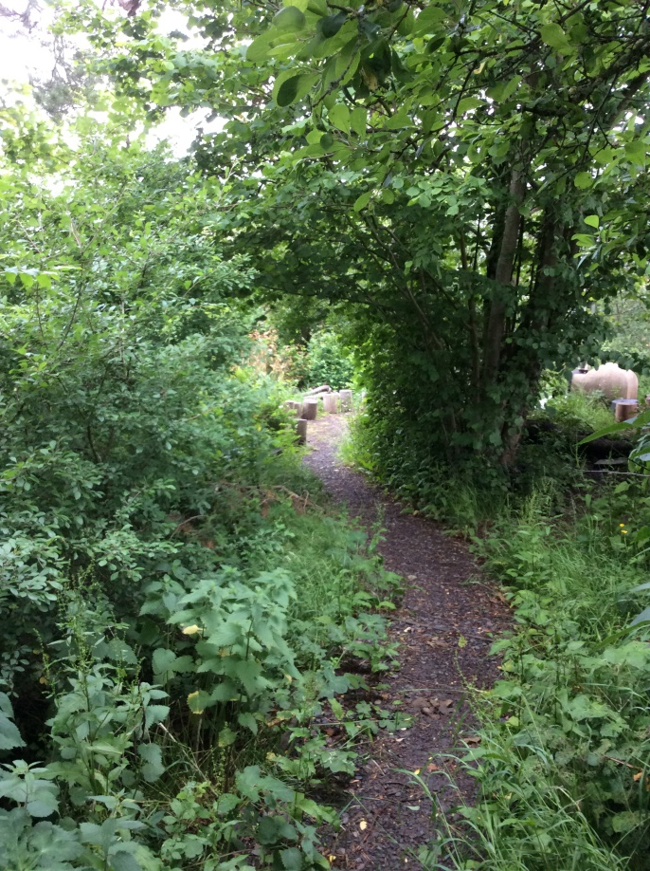
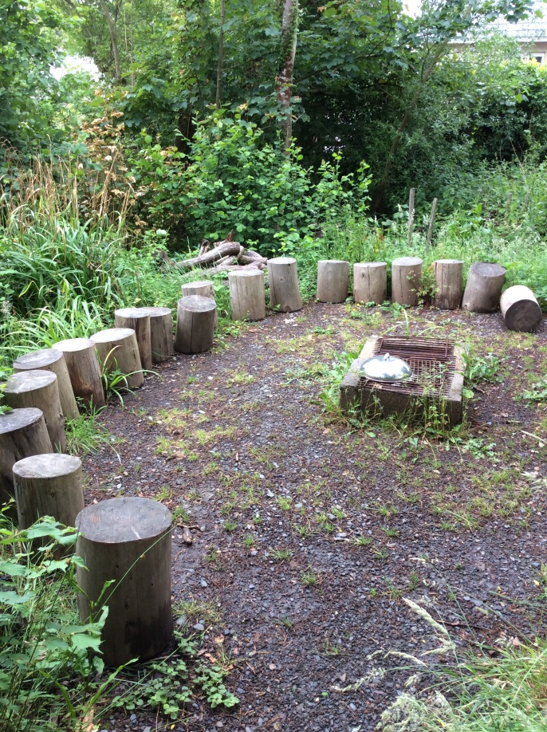
The Woodland Area.
We use this area at least once a week.

Slide 15
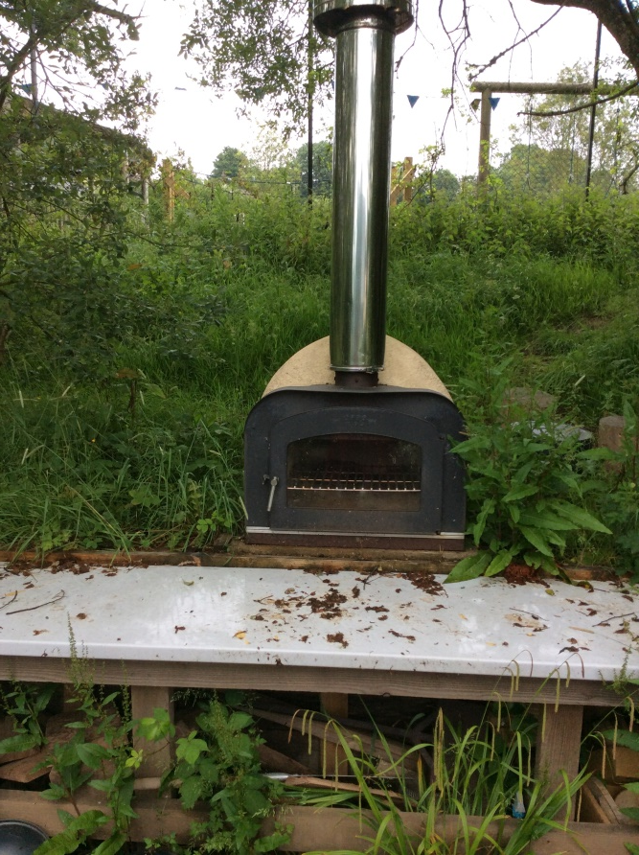
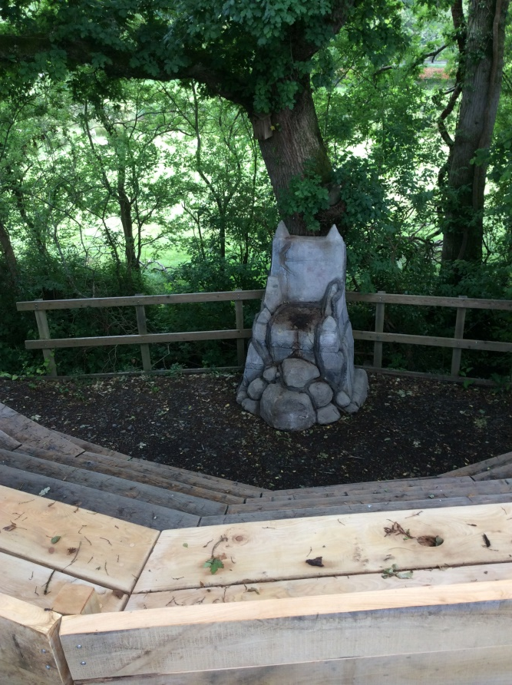
We even have a pizza oven, amphitheatre and story telling throne!

