Slide 1
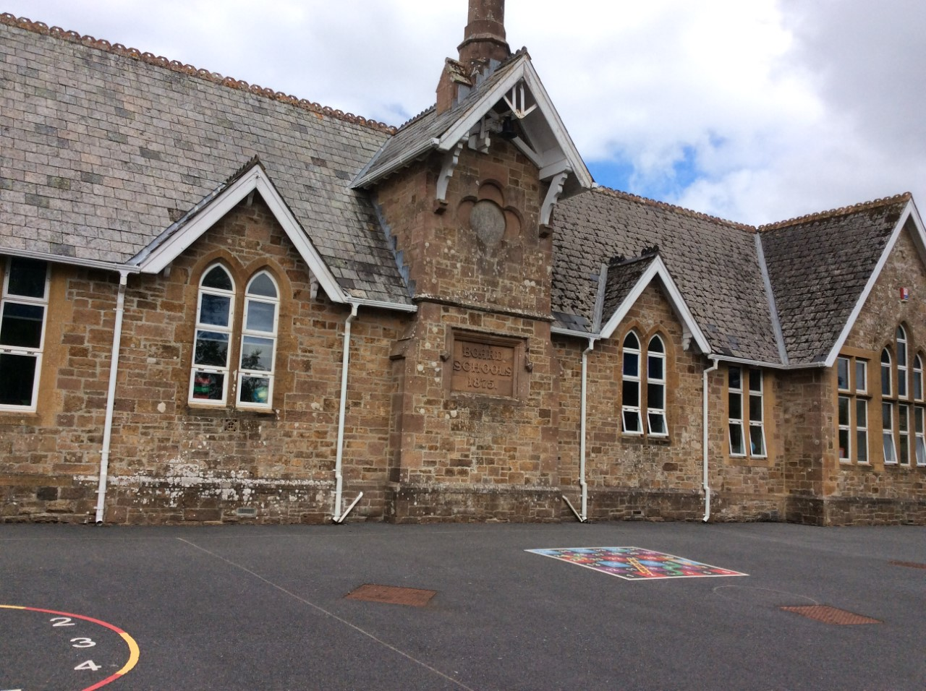
Hatherleigh Community Primary School
EYFS

Slide 2
The purpose of this presentation is :
To help you to understand the curriculum we will be teaching in the Reception class.
To understand the different ways in which we teach and your child will learn.
To identify the key ways in which you can help your child at home.
To help you child make the best possible start to school.
Notes:
Parent partnership is key, a two way flow of information is essential
Every child deserves the best possible start in life and the support that enables them to fulfil their potential. Children develop quickly in the early years and a child’s experiences between birth and age five have a major impact on their future life chances. A secure, safe and happy childhood is important in its own right. Good parenting and high quality early learning together provide the foundation children need to make the most of their abilities and talents as they grow up.

Slide 3
What is the Early Years Foundation Stage?
The Early Years Foundation Stage (EYFS) is the stage of education for children from birth to the end of the Reception year.
It is based on the recognition that children learn best through play and active learning.
It is a continuation of the same curriculum as in pre-school settings/ nurseries.

Slide 4
There are seven areas of learning and development:
Prime areas
    Communication and Language
    Personal Social and Emotional development
    Physical Development
  Specific Areas
    Literacy
    Mathematics
    Understanding the World
    Expressive Arts and Design
    There are 17 Early Learning Goals against which each child is assessed at the end of the reception year and a best fit judgement is made.
Notes:
All areas of learning and development are important and inter-connected.
The prime areas are important for building the foundations, it is through the specific areas that the primes are strengthened

Slide 5
There are also three characteristics of effective teaching and learning
Playing and exploring
Active learning
Creating and thinking critically
These tell us about how each child learns not what they are learning.
Notes:
We look for things such as what engages or motivates a child, problem solving, resilience, changing strategy etc.

Slide 6
The importance of play
Play is essential for children’s development, building their confidence as they learn to explore, relate to others, set their own goals and solve problems. Children learn by leading their own play, and by taking part in play which is guided by adults.
Notes:
Yes, children will still be playing in reception, but we will plan high quality learning experiences, a well-planned environment and have skilful adults who support that learning.
There will also be times when children are

Slide 7
Developing children’s language and vocabulary
There is a big focus on early language and extending vocabulary. We will do this by:
Having quality learning conversations and interactions with the children.
Reading a range of stories, poems, rhymes and non-fiction texts.
Teaching new and exciting vocabulary.
Notes:
There is a big focus on early language and extending vocabulary, with more examples on how to embed and develop vocabulary skills across all 7 areas, because this improves child development in a broad curriculum

Slide 8
What can you do to help your child?
Chat, play with and read to your child daily.
Sing nursery rhymes together.
Listen to your child read regularly.
Encourage them to be independent.
Play board games with them.
Notes:
The help that they give their children at home has a very significant impact on their learning

Slide 9
Typical Daily Structure
Our daily structure is usually:
Registration
Literacy (Drawing Club)
PE
(Fruit, milk and water are available throughout the morning and children can help themselves when they choose)
Break
Phonics
Singing/ nursery rhymes
Lunch
Registration
Maths
Topic/ PSHE
Story
Home time
Continuous provision activities are set up for the children to access whenever they choose. These activities change with the children’s interests.

Slide 10
Messy Play
Learning in Reception is not always clean! Please be understanding.
We have days where the children spend time in the woodland area. They require welly boots in school for this.

Slide 11
The First Few Weeks
We will find out what the children already know and can do. We use this to help us develop our curriculum.
Within the first few weeks we complete the statutory Baseline Assessment. We also make our own observations and assessments.
We spend lots of time working with and talking to the children about their learning. We may record some ‘Wow’ moments but we largely assess and move the children on ‘in the moment’ so not everything gets recorded.
We share learning and messages with you using Class Dojo.

Slide 12
Medical Matters
Any sickness or diarrhoea must be followed by 48 hours absence from school.
If your child is ill please telephone the school office before 9:00am.
Headlice are common! Please check your child regularly and treat as recommended.
NO NUTS! We are a nut free school.

Slide 13
What does my child need at school?
A waterproof coat.
Water bottle.
PE shoes- plimsolls or trainers (no laces please).
Welly boots on certain days but you can leave a pair at school if easier.
Book bag- Please bring this every day.
A sun hat during warmer weather.
PLEASE NAME EVERYTHING!

Slide 14
Finally
You will have regular updates on your child’s progress.
If you have any questions or concerns please speak to us directly or email year0@hatherleigh-pri.devon.sch.uk
You will also be able to message us via Class Dojo which will be set up in September.

