Slide 1
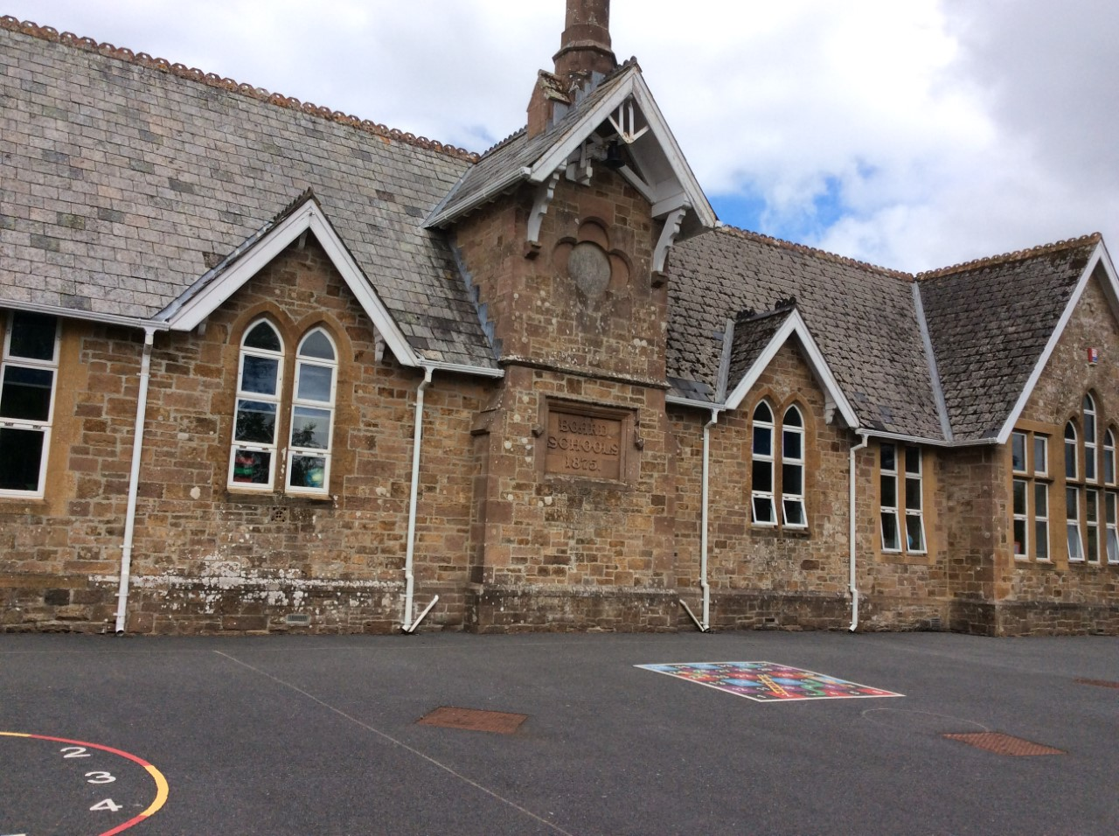
Hatherleigh Community Primary School
EYFS 2026/27
Meet the Teacher(s)

Slide 2
Meet the team
Teachers: Miss Tucker (Mon-Thurs)
Mrs Byers (Friday)
Teaching assistants:
Sarah Hill- Monday to Thursday
Mrs Sam Valdmane- Friday
Mrs Sam Hill - PPA cover Wednesday afternoon from 1:25pm.

Slide 3
Topic
First half term:
Me and my family- We will spend lots of time getting to know each other and discussing similarities and differences.
Second half term:
People who help us- We will be looking for volunteers to come in and speak to the class about a variety of careers.
Christmas!
Planning is on the website. This is a rough guide.

Slide 4
Reading
All children will have picture books until they learn to blend.
Assessments determine which book level children are reading. Matched to their secure phoneme recognition and segmenting ability.
Decodable books. Read 3x in school first. Usually allocated on a Thursday.
Sharing book to keep for a week. Chosen by child. To be read together. Usually changed on a Thursday.
Please record in reading diaries. Reading certificate for 4+ reads per week.
Please keep books/ reading diary in plastic file..
Notes:
Parent partnership is key, a two way flow of information is essential
Every child deserves the best possible start in life and the support that enables them to fulfil their potential. Children develop quickly in the early years and a child’s experiences between birth and age five have a major impact on their future life chances. A secure, safe and happy childhood is important in its own right. Good parenting and high quality early learning together provide the foundation children need to make the most of their abilities and talents as they grow up.

Slide 5
Phonics
Taught daily - digraphs and trigraphs.
Saying for each sound - ow - wow owl.
Usually 4 sounds a week. Practise at home in sound books.
Tricky words - read then spell. Learn the whole word.
Correct pronunciation of sounds. Not adding ‘u’ (schwa).
Phonics workshop- Thursday 24th 2:30pm

Slide 6
Phonic Vocabulary
Digraph - 2 letters working together to make one sound e.g. ar
Trigraph - 3 letters working together to make one sound e.g. igh
Blending – putting sounds together to make words eg c…a…t cat.
Segmenting – recognising the sounds in words for reading eg. dog d…o…g using segmenting fingers.

Slide 7
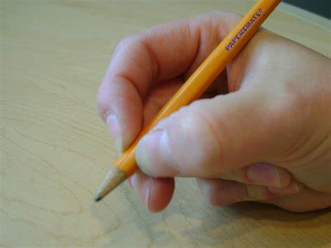
Writing
Start with mark making and learning to write own name (please help at home)
Strengthen hands- threading, playdough, pegs, squeezing spray bottles, elastic bands…
Tripod pencil grip (ditty).
Correct letter formation is very important. Use ditty - a - ‘around the astronauts helmet and down into space’.
Begin to write captions and simple sentences.
Use phonic knowledge to spell
words - ‘segmenting fingers’.
Notes:
We look for things such as what engages or motivates a child, problem solving, resilience, changing strategy etc.

Slide 8
Language and vocabulary
There is a big focus on early language and extending vocabulary. We will do this by:
Quality learning conversations and interactions with the children, especially during COOL time.
Reading a range of stories, poems, rhymes and non-fiction texts.
Teaching new words and vocabulary (wow words).
High quality vocabulary used in Drawing Club.
Notes:
There is a big focus on early language and extending vocabulary, with more examples on how to embed and develop vocabulary skills across all 7 areas, because this improves child development in a broad curriculum

Slide 9
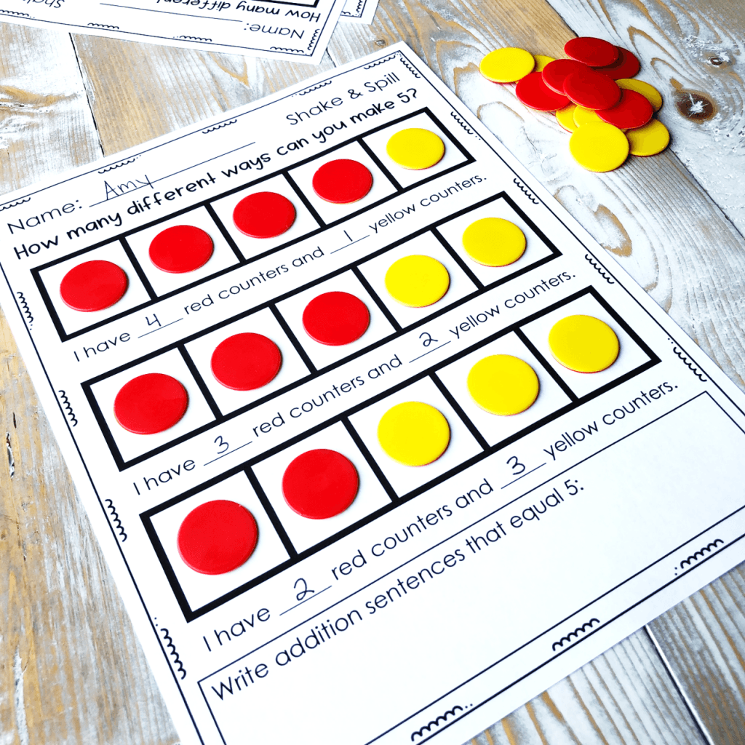
Composition of numbers
Maths workshop- Date TBC
Deep understanding of number to 10, including composition of each number.
Counting to 20.
    How many ways can we
    make 5?
    Number bonds to 5 and
    then 10.
Notes:
All areas of learning and development are important and inter-connected.
The prime areas are important for building the foundations, it is through the specific areas that the primes are strengthened

Slide 10
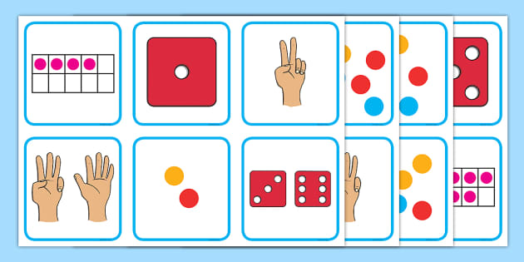
Subitising
Recognition of the number of objects in a group without counting them.

Slide 11
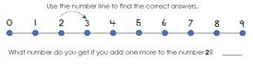
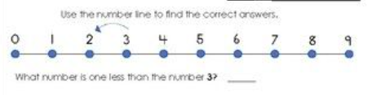
Numerical patterns
Explore and represent patterns within numbers, up to 10.
    1 more than/1 less than. How can we show that on the numberline?
Notes:
All areas of learning and development are important and inter-connected.
The prime areas are important for building the foundations, it is through the specific areas that the primes are strengthened

Slide 12
The importance of play
Play is essential for children’s development, building their confidence as they learn to explore, relate to others, set their own goals and solve problems. Children learn by leading their own play, and by taking part in play which is guided by adults.
COOL time/ independent play/ cooperative play/ guided play.
Notes:
Yes, children will still be playing in reception, but we will plan high quality learning experiences, a well-planned environment and have skilful adults who support that learning.
Inside and out
Free flow

Slide 13
Messy Play
Learning in Reception is not always clean or dry! Please be understanding.
We spend time in the woodland area most Friday afternoons. Children require welly boots and waterproof coats in school every Friday.

Slide 14
Assessment
Baseline Assessment -within the first 6 weeks.
Phonics and reading half termly- assessments shared in sound books.
‘Keep up’ phonics intervention every 3 weeks.
Ongoing through daily interactions and observations.
End of the year final judgement - 17 Early Learning Goals- met (expected) or not met (emerging).

Slide 15
How to help your child
Chat, play and read to your child daily.
Sing nursery rhymes together.
Read traditional tales.
Encourage them to be independent.
Play board games with them and don’t always let them win.
Notice numbers and patterns.
Practice name writing.
Notes:
The help that they give their children at home has a very significant impact on their learning

Slide 16
Home Learning
Read books regularly (at least 4 x weekly).
Practice sounds and tricky words in pink sound books weekly but return to them regularly.
Access Numbots regularly (independently).
Read sharing book.

Slide 17
Dojo
We will send messages and reminders. We will share group and individual photos and videos.
Only a small part of a child’s learning takes place in school. We love seeing what you have been doing at home. Please share photos and videos on your child’s portfolio, then we all celebrate it together at school.
Please message the correct teacher for the day 7:30am-6pm. If we don’t reply and it is important, please contact the office.

Slide 18
Important Messages
Coat every day.
Trainers every day.
Welly boots every Friday.
Please name everything!
Please be patient- We try to respond to Dojo messages throughout the day but we have lots of other responsibilities within school.
Please step forward/wave to receive your child at the end of the day. If you need to speak to us please wait until we have safely released all children.
Please send spare clothes+ wet wipes/ nappy sacks if your child is likely to have an accident.

Slide 19
Dates
Little Wandle Phonics parent meeting- Thursday 24th Sept 2:30pm.
Whole school walk- Friday 25th Sept.
Maths workshop to parents- TBC
Hatherleigh carnival- Saturday 14th November.
Road safety week and Anti bullying week 16th-20th November. With odd sock day on Monday 16th November.
Children in need- Friday 20th November.
Parents evening- December 1st/2nd.
Christmas play- TBC

Slide 20
Any questions?

