Slide 1

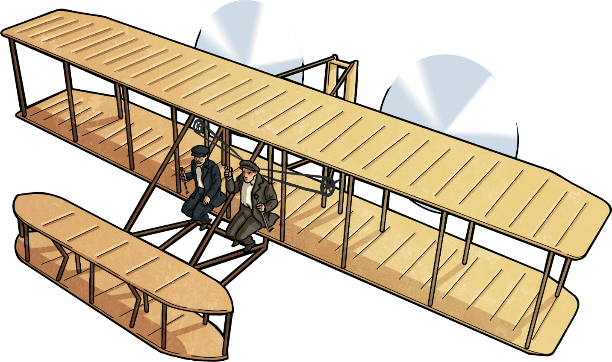

Slide 2
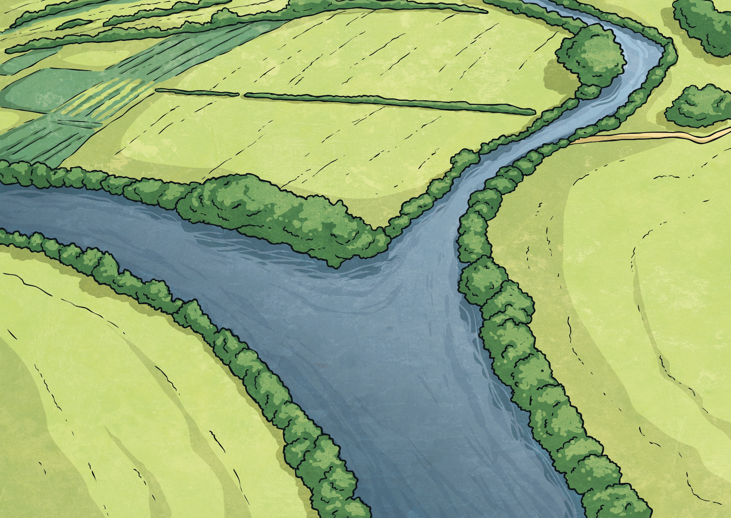
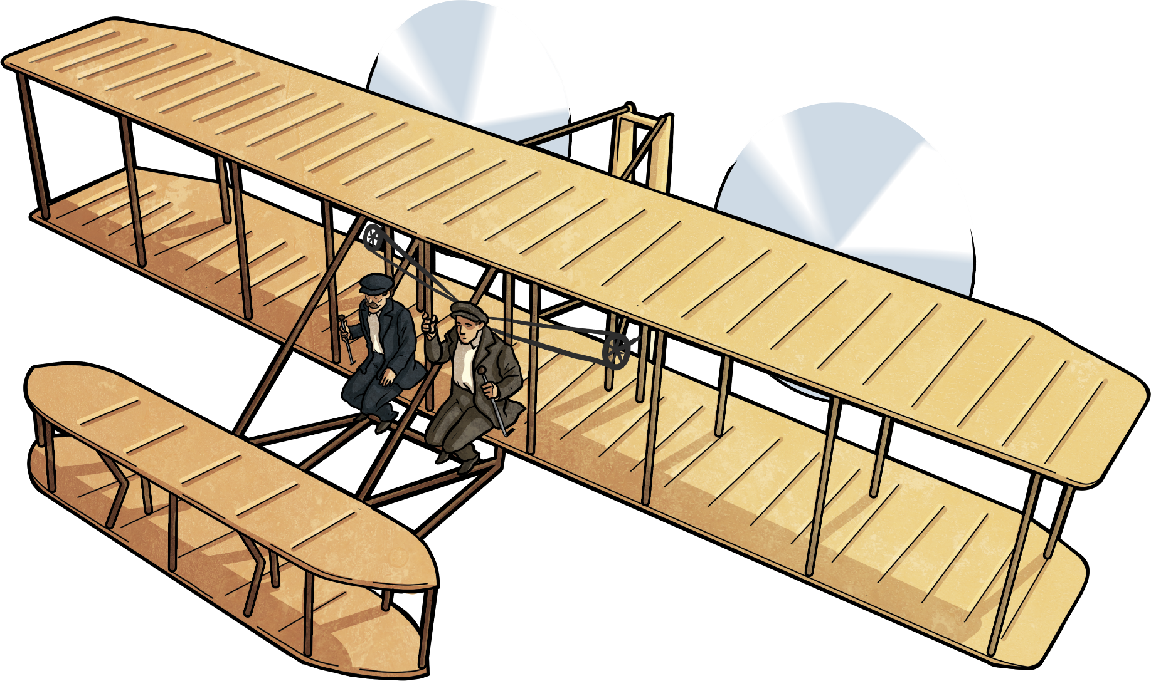
In December of 1903, two brothers changed life as we know it with the first auto-powered heavy machine airplane.

Slide 3
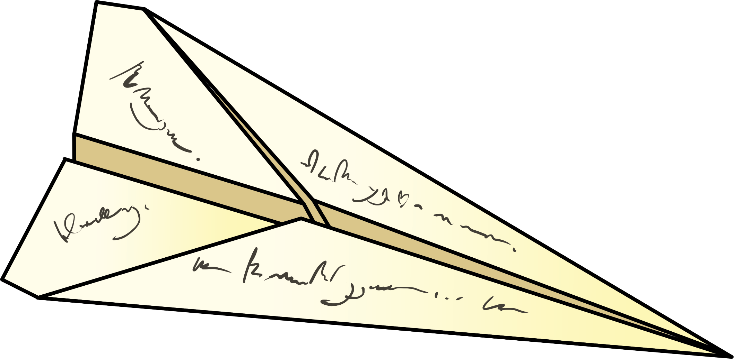
In the beginning…
    The Wright Brothers became interested in flying after they received a helicopter as a gift from their father. They observed the movements of wind
    speed, the wingspan, and how it was similar
    to a bird in flight. This propelled them into wanting to learn more and eventually
  create their prototype.

Slide 4
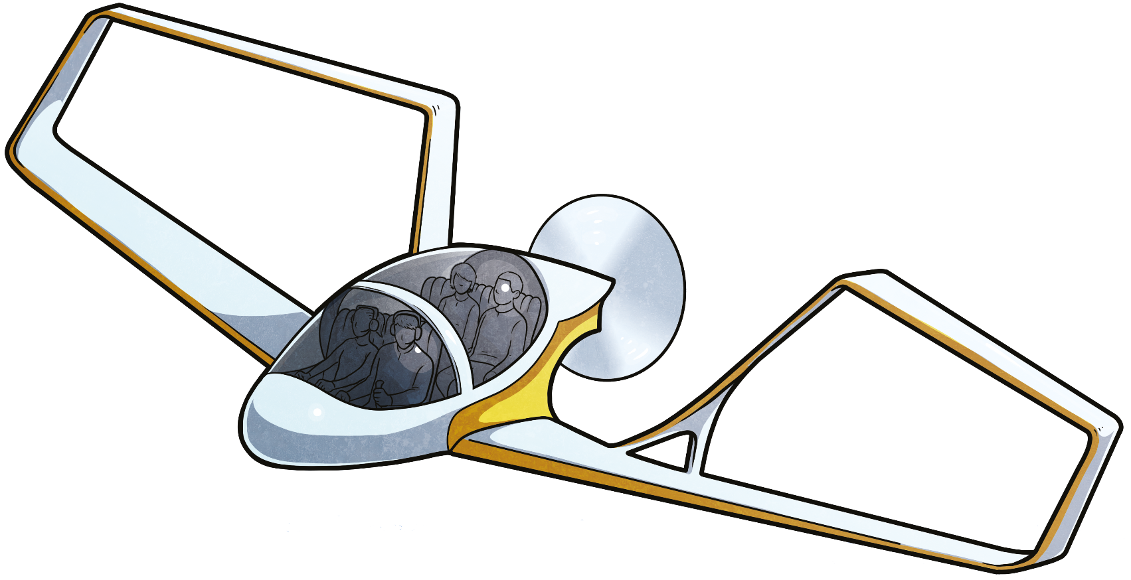
Create your own paper plane
Take a piece of paper, a ruler, pencil, eraser,
and your imagination!
Design your own plane! (It could be a futuristic plane – one that no one has seen or imagined as of yet!)

Slide 5
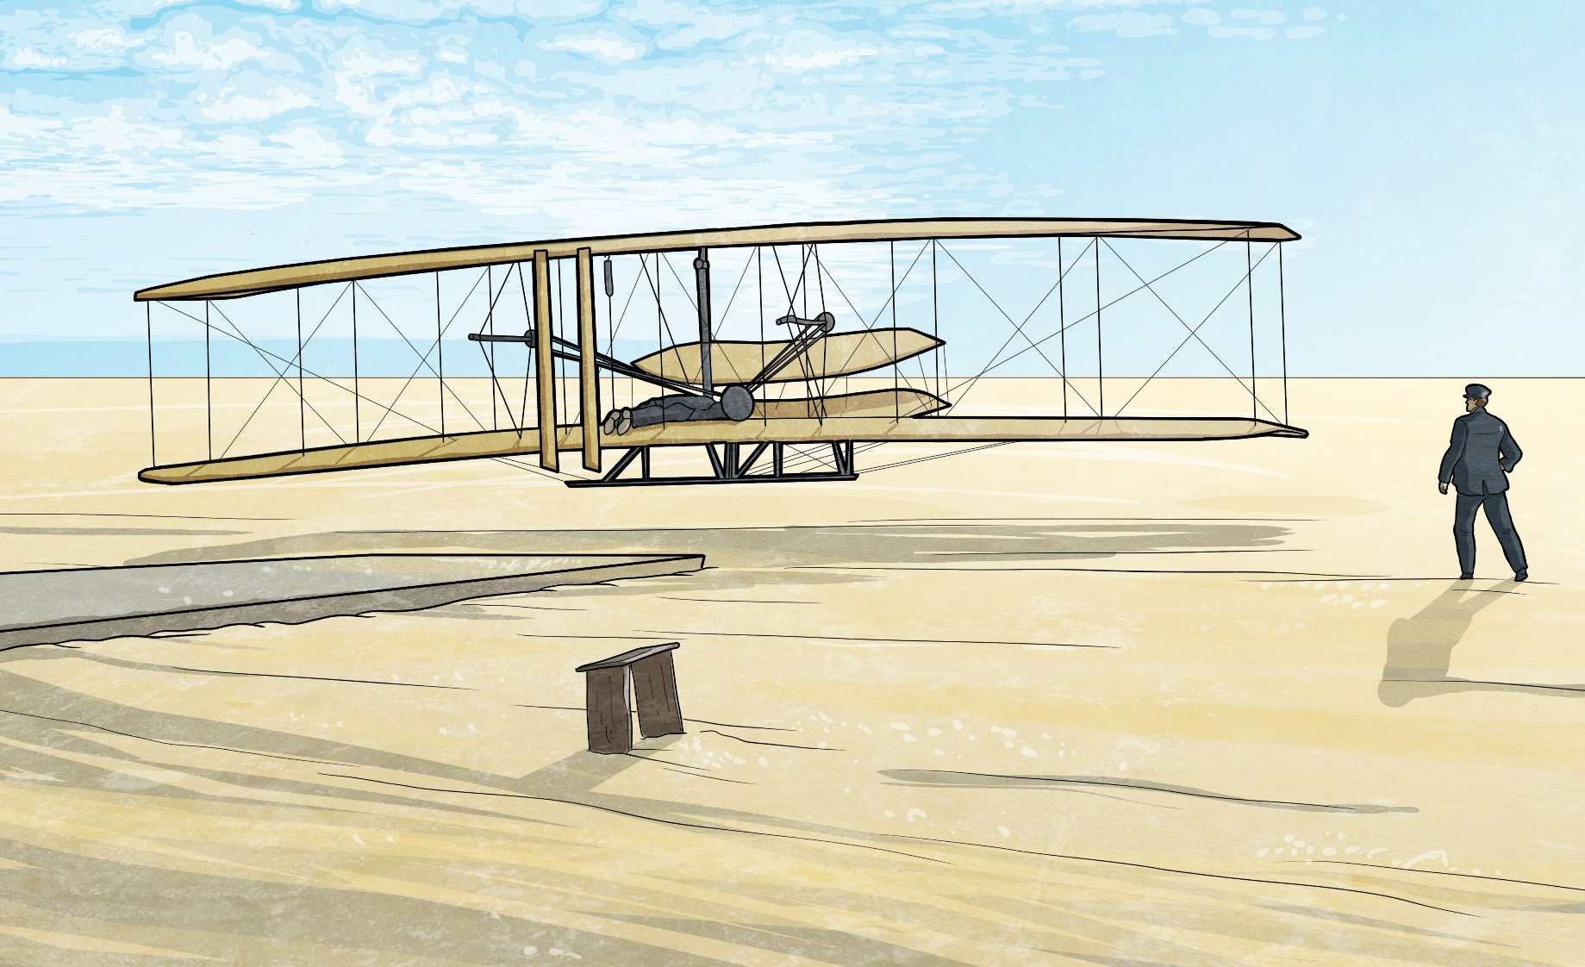
As they progressed…
As their forward-thinking of flight increased, so did their air discoveries. The brothers were able to build a flying contraption that would eventually take flight in 1903 in Kitty Hawk, North Carolina. Wilbur was the first to pilot such an amazing, heavy-duty plane to ascend into the air.

Slide 6
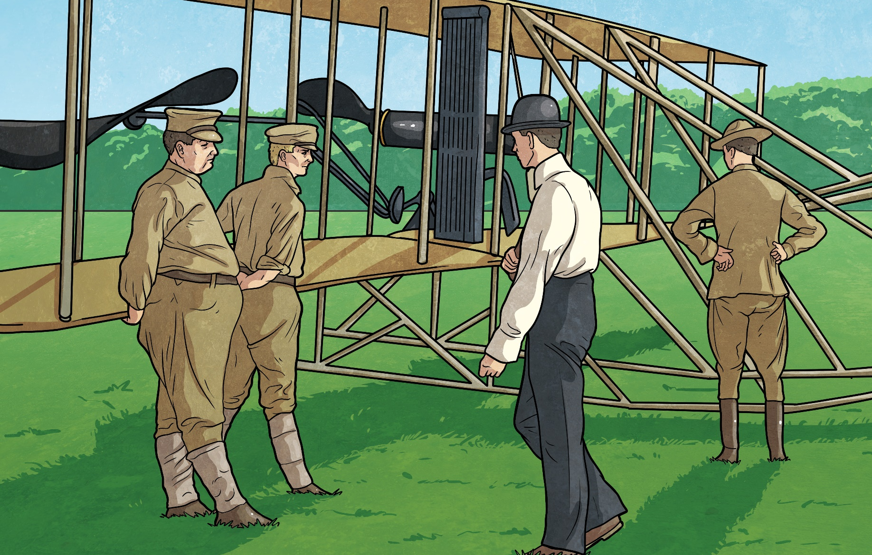
Business in Aviation
After their success with the first airplane with passenger capacity, they began to look at business expansion. The brothers were able to find this through the United States military and the French. The United States Army requested an airplane crafted by the Wright Brothers, while the French asked for the impossible to be created - a two-passenger aircraft with an increased high-powered engine. The Wright Brothers did not disappoint! However, they chose to take different flying paths in separate countries. Eventually, the flying duo joined forces once again.

Slide 7
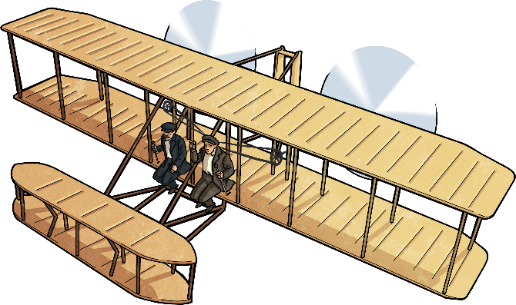
Airplane Factories, Flight School, and Legal Battles
As the airplane industry began to take form and emerge with limitless possibilities, orders for airplanes showered the brothers. They also developed a flight school, teaching others how to fly.

Slide 8
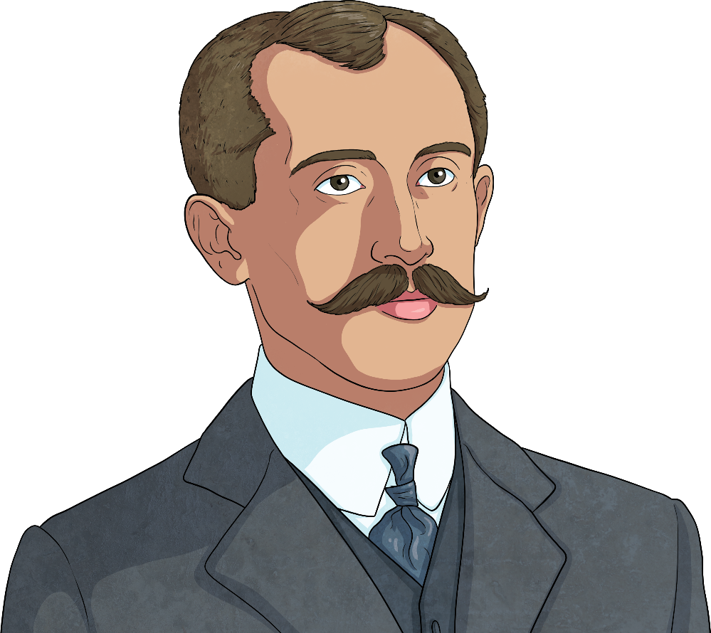
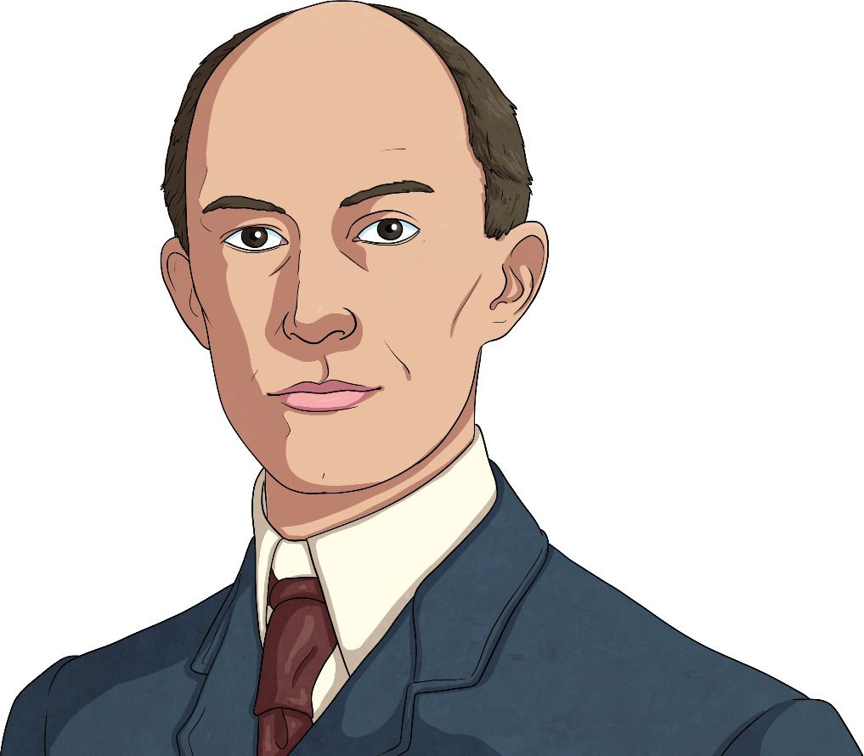
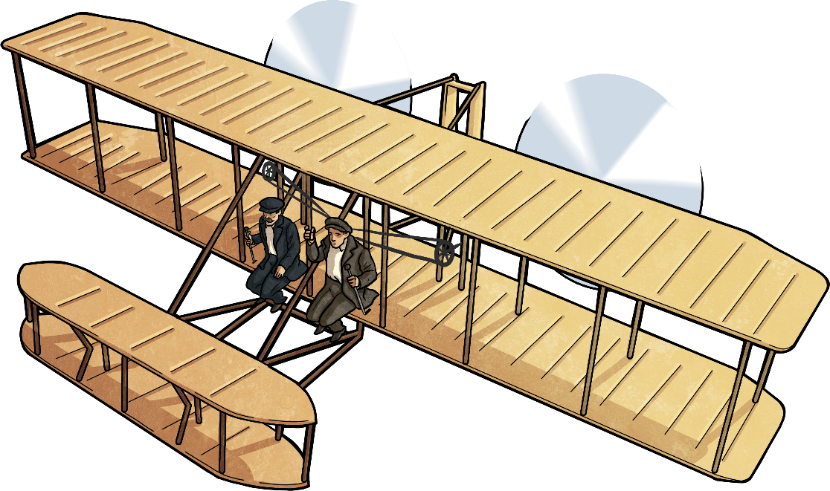
December 17th is Wright Brothers Day to celebrate their amazing accomplishments to aviation!
People from around the world are asked to celebrate or recognize their first flight experience.

Slide 9
Here are some attempts from other people before the Wright Brothers found success.

