Slide 1
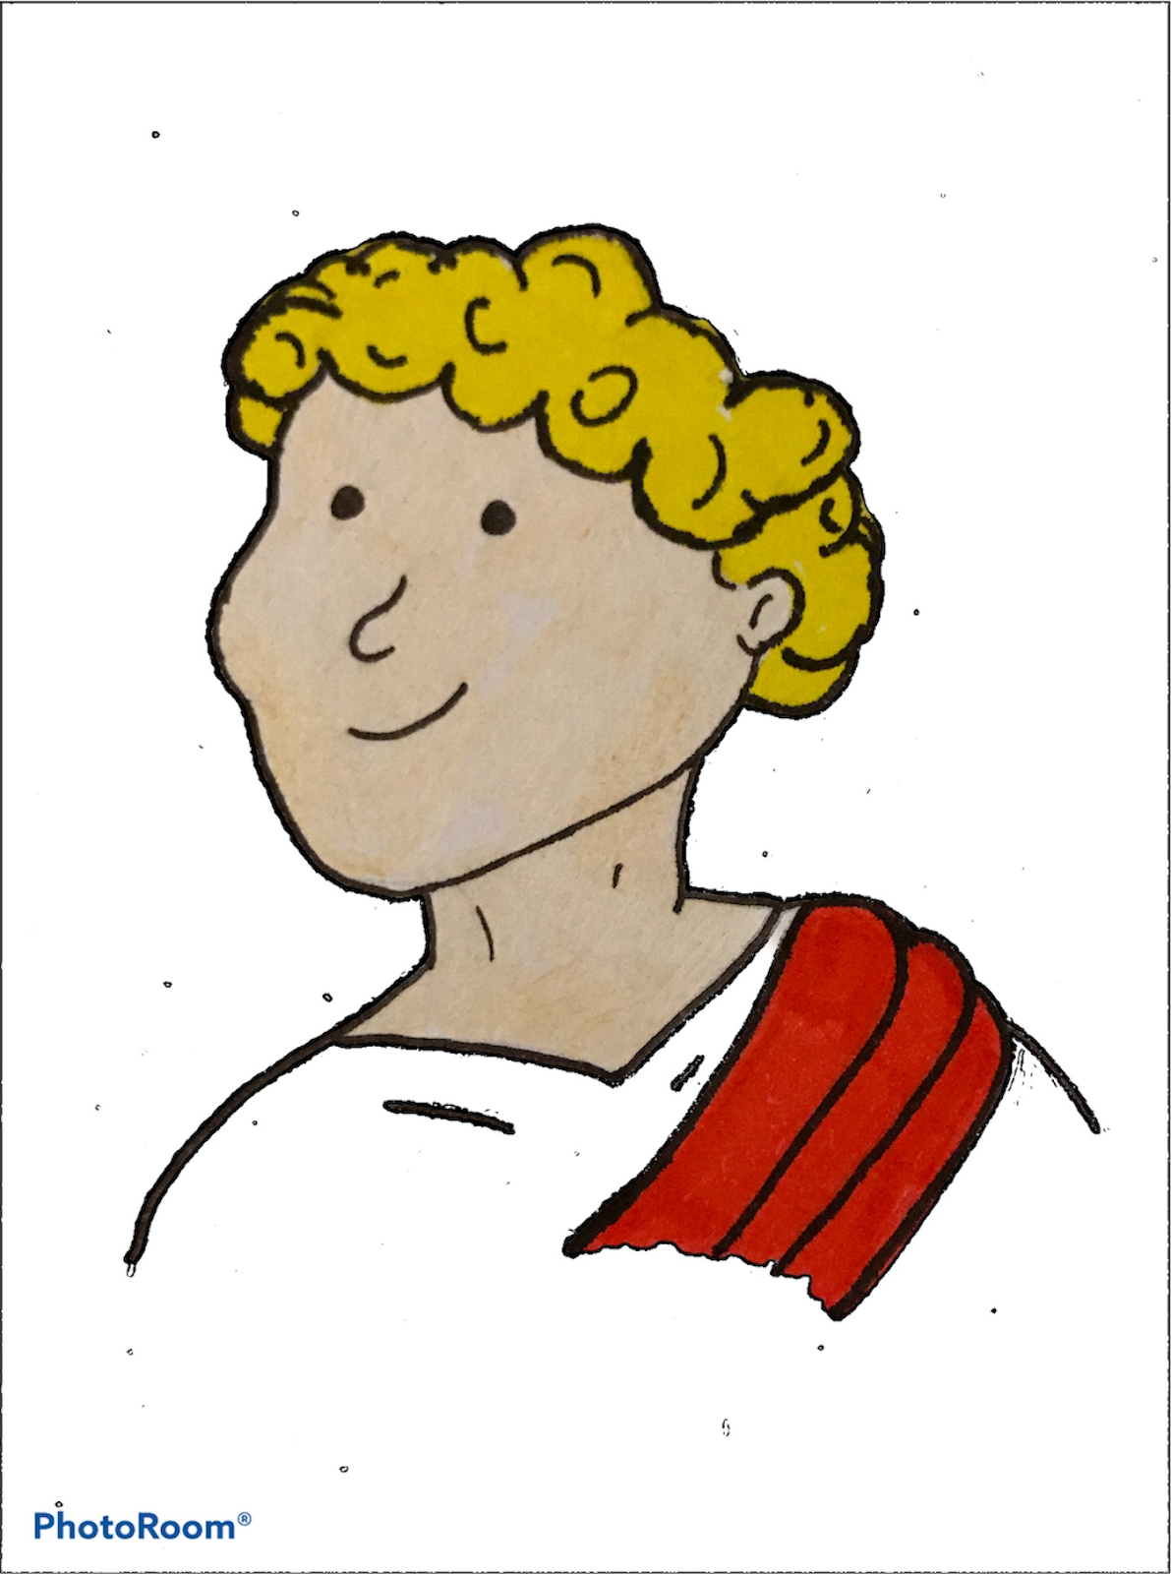
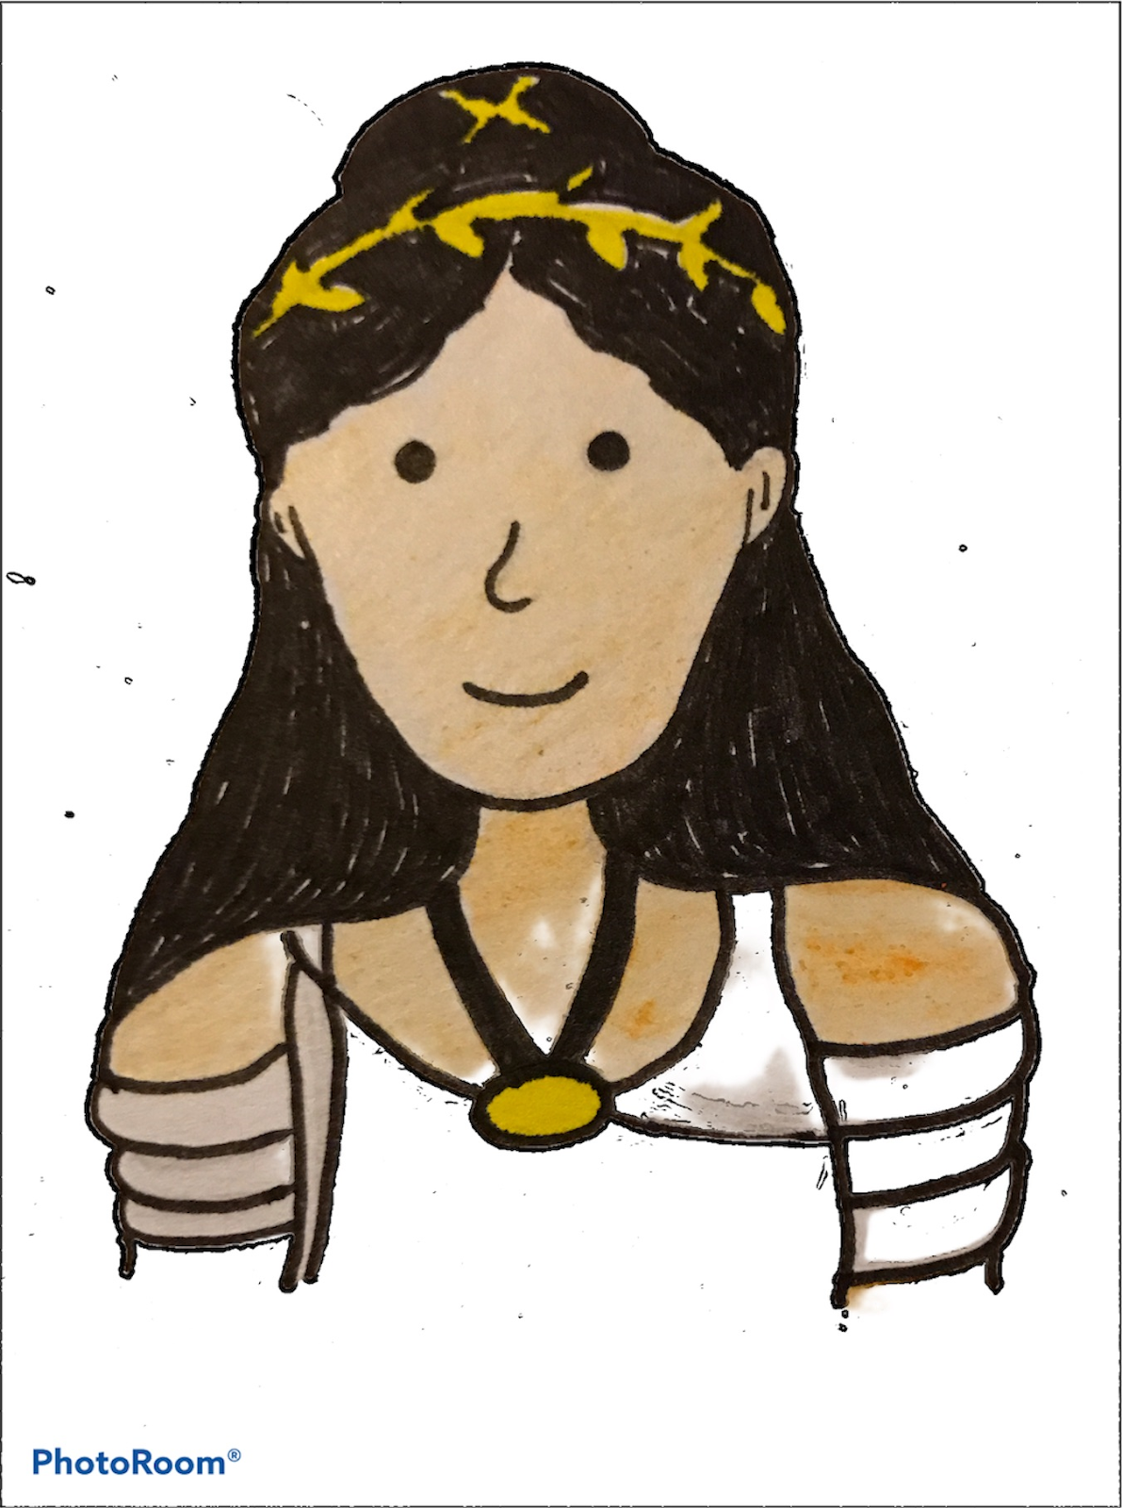
I can identify and use adverbs of manner and time.
Adverbs of Manner
Adverbs of Time
Adverbs of manner tell us how something happens - they describe how the verb happens. They mainly end in –ly.
They moved quickly in front of the Palace.
Lucy spoke proudly of her father’s importance.
They had to sneakily think of a plan to hide who Joe really was.
Adverbs of time tell us when a verb happens, for how long and how often.
Today, Joe has appeared in Ancient Rome!
Daily, the family visit the Roman Baths.
They eat at a low table sometimes.
Copyright © Teaching From Text

Slide 2
I can identify and use adverbs of manner and time.
Adverbs of Manner
Adverbs of Time
quickly
swiftly
slowly
calmly
sneakily
quietly
loudly
fast
carelessly
carefully
joyfully
foolishly
happily
grumpily
kindly
doubtfully
mischievously
angrily
perfectly
neatly
hungrily
awkwardly
nervously
anxiously
accidentally
cheerfully
greedily
gracefully
now
then
today
tomorrow
yesterday
tonight
later
earlier
daily
weekly
hourly
always
then
before
already
next
after
never
occasionally
often
sometimes
usually
finally
eventually
Copyright © Teaching From Text

