Slide 1
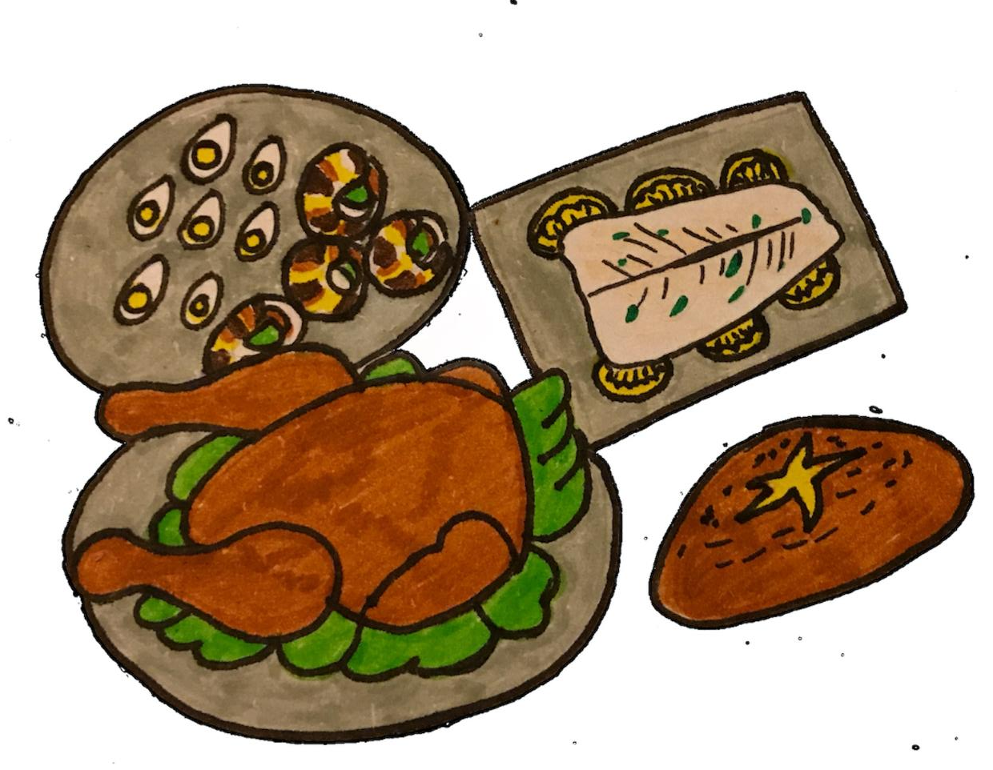
LI: I can expand noun phrases by adding modifying adjectives, nouns and prepositional phrases.
What are expanded noun phrases?
An expanded noun phrase provides more information about a noun, for example:
The expanded noun
phrase –
the quails’ eggs
can be improved with an additional noun:
The noun
phrase –
the eggs
‘quails’’ is an additional noun to describe the ‘eggs’.
Copyright © Teaching From Text

Slide 2
LI: I can expand noun phrases by adding modifying adjectives, nouns and prepositional phrases.
An expanded noun phrase provides more information about a noun, for example:
can be improved with adjectives:
The noun
phrase –
the quails’ eggs
The expanded noun
phrase –
the small, appetising
quails’ eggs
‘small’ and ‘appetising’ are adjectives to describe the ‘quails’ eggs’.
Copyright © Teaching From Text

Slide 3
LI: I can expand noun phrases by adding modifying adjectives, nouns and prepositional phrases.
An expanded noun phrase provides more information about a noun, for example:
The expanded noun
phrase –
the small, appetising
quails’ eggs on the silver
platter.
can be improved with a prepositional phrase:
The noun
phrase –
the small, appetising
quails’ eggs
‘on the silver platter’ is a prepositional phrase to describe the ‘small, appetising quails’ eggs’.
Copyright © Teaching From Text

Slide 4
LI: I can expand noun phrases by adding modifying adjectives, nouns and prepositional phrases.
Copyright © Teaching From Text

Slide 5
LI: I can expand noun phrases by adding modifying adjectives, nouns and prepositional phrases.
The crusty, warm spelt loaf with oozing butter melting inside.
The small, appetising quails’ eggs on the silver platter.
The spicy, mouth-watering chicken drumsticks ripped from the carcass.
The poached, pink salmon fish laying on a bed of lemon.
The green, crisp salad leaves underneath the spiced chicken.
The crisp and juicy garlic snails farmed within the Palace’s gardens.
Copyright © Teaching From Text

