Slide 1
Multiplying 3 numbers

Slide 2

Look at the image below.
What multiplication number sentence can we use to calculate the number of eggs

Slide 3
All say…
3x2=6
2x3=6
How can we use that number sentence to work out the image on the next slide?

Slide 4
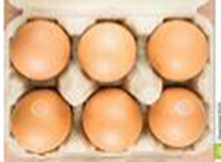
Discuss….

Slide 5
There are 6 lots of 6 eggs 6x6
We could also say…
3x2x6
Is it the same answer if we reorder the digits? Jot workings in Maths jotters
6x2x3 3x6x2 6x3x2 2x6x3 2x3x6

Slide 6
3x2x6 6x2x3 3x6x2 6x3x2 2x6x3 2x3x6
3x2x6 3x2=6 6x6=36
Remember we must not write 3x2=6x6=36 = means the same as
6x2=12 12x3=36
3x6=18 18x2=36
2x6=12 12x3=36
2x3=6 6x6=36
Who had these calculations?

Slide 7
How about this image?
Write the different combinations to work out how many eggs.
Discuss

Slide 8
How about this image?
Discuss what the different calculations mean. Repeat as class for each one.
6x5=30 5x6 = 30 (5 lots of 6 eggs)
2x3x5 2x3=6 6x5=30 (2 rows of 3 eggs in a box, 5 boxes)
5x3x2 5x3=15 15 x2 (5 boxes of eggs with 3 lots of 2 in a box)
5x2x3
3x5x2

Slide 9
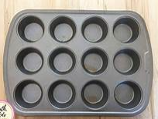
How could you calculate how many cupcakes could be made? Look for the different groups.
Hint on the next slide if needed

Slide 10
Hint…..
We could make 1 tray 3 groups of 4, 4 groups of 3, 2 groups of 6, 6 groups of 2 and there are 3 tins. Write your workings in your jotter

Slide 11
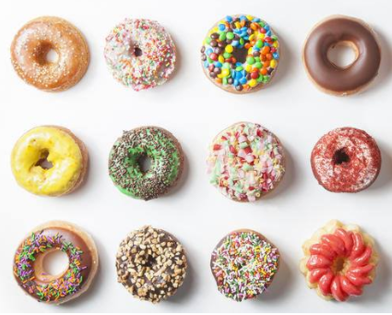
Task
Look at the copy of this image.
What different ways could you calculate the answer?

