Slide 1
Science - Year 4
Living Things & their Habitats
Name That Living Thing!
Session 4
Drawing PowerPoint

Slide 2
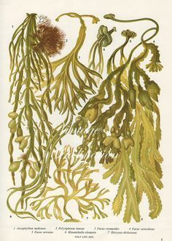
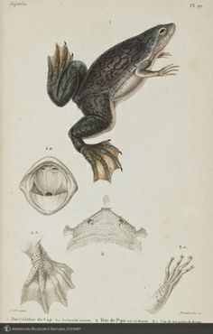
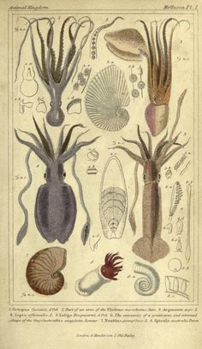
For centuries, scientists have used careful and detailed drawings to better understand living things.

Slide 3
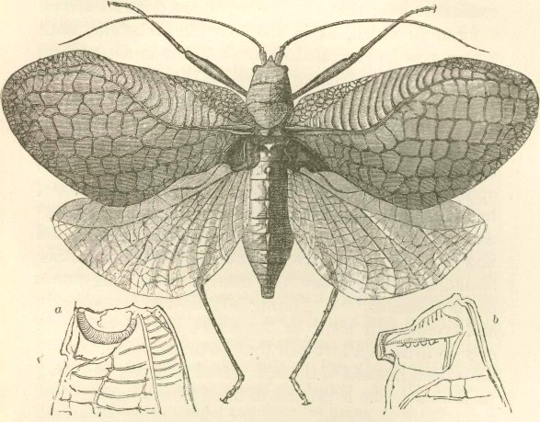
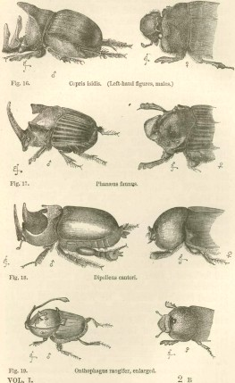
The detailed drawings by naturalist Charles Darwin helped us to better understand living things from around the world.

Slide 4
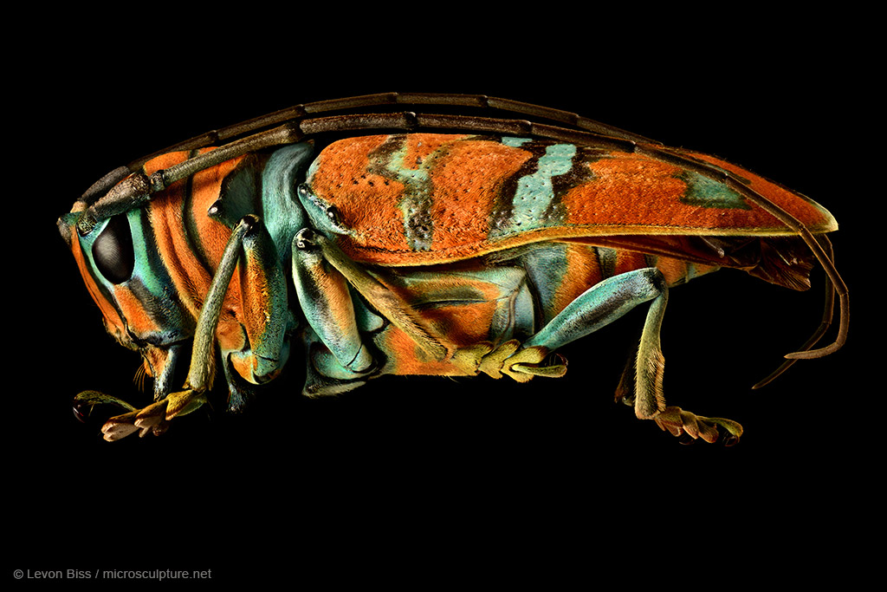
Although sketches and notes are still made by scientists, the artist Levon Biss is using a more modern approach to capturing the detail of some beautiful invertebrates.
http://microsculpture.net/

